Slide 1
Performance Estimation, Testing, and Control of Cyber-Physical Systems Employing Non-Ideal Communications Networks
Richard Candell
PhD Thesis
28 September 2020
LIB Laboratory
University of Burgundy
Notes:
LIB - Informatics Lab
Pardon for not speaking in French

Slide 2

About Me
Richard Candell, BSEE, MSEE, University of Memphis
Experience
12 Years Software-defined Radio, SATCOM, Cellular
6 Years Industrial Wireless Systems at NIST
Early Career in Manufacturing
Cybersecurity at NIST
Current Role:
Project Leader: Industrial Wireless Systems at NIST
Chair of the NIST Industrial Wireless Technical Working Group
Notes:
Rick Candell, MSEE
12 years: Tactical Radio Systems and SATCOM
Real-time Embedded, radio systems, SDR
Early career: manufacturing of wood products
Current role: Researcher at NIST
Project Leader: Wireless Platforms for Smart Manufacturing
With NIST since Sept. 2013
Other Roles: Cybersecurity Testbed
Interests:
CPS impacts of lossy networks
Uses of AI in manufacturing and IWNs
Wireless propagation and recreation of RF environments

Slide 3
Agenda
Thesis Context
Introduction to Cyberphysical Systems in Smart Manufacturing
Industrial Wireless Requirements
SysML: Workcell Architectural Decomposition and Analysis
Application of the Graph Databases to CPS Experiments
Machine Learning in a Robotic Force Seeking Application
Conclusion

Slide 4
Thesis Context
Thesis Context
Introduction to Cyberphysical Systems in Smart Manufacturing
Industrial Wireless Requirements
SysML: Workcell Architectural Decomposition and Analysis
Application of the Graph Databases to CPS Experiments
Machine Learning in a Robotic Force Seeking Application
Conclusion
Performance Estimation, Testing, and Control of Cyber-Physical Systems Employing Non-Ideal Communications Networks
Thesis Presentation 28 September 2020
Richard Candell

Slide 5
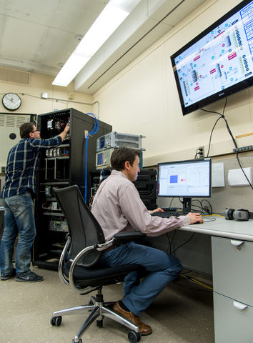
The NIST Industrial Wireless Project – A Context for Research
Part of larger project at NIST
Includes hands-on testbed design and implementation with real hardware

Slide 6
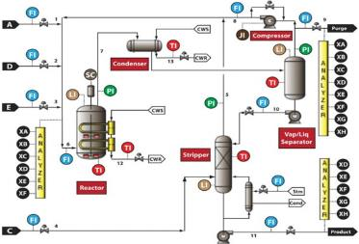
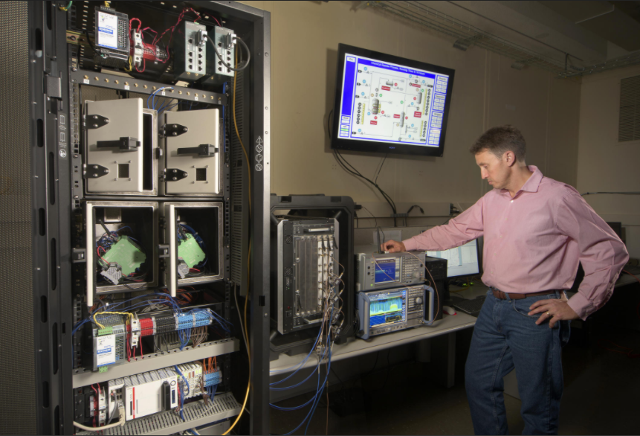
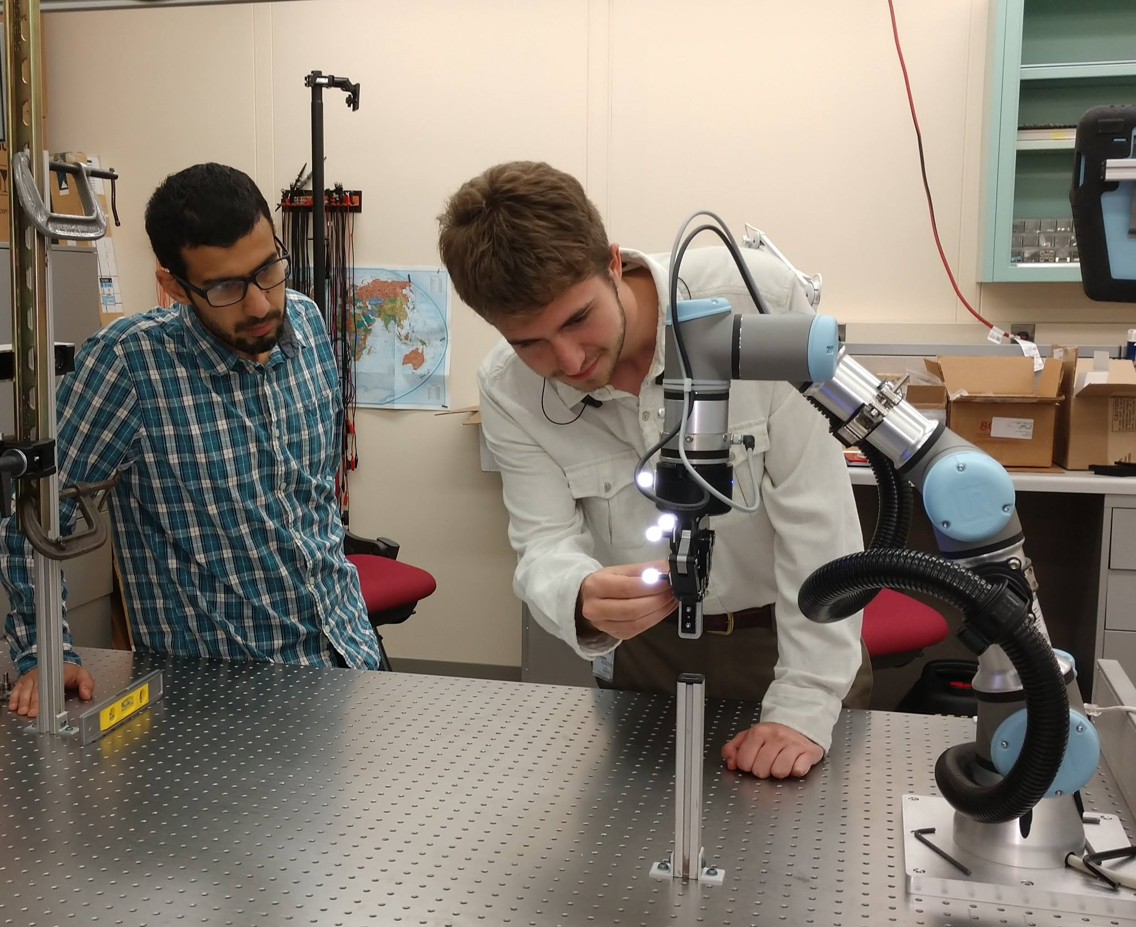
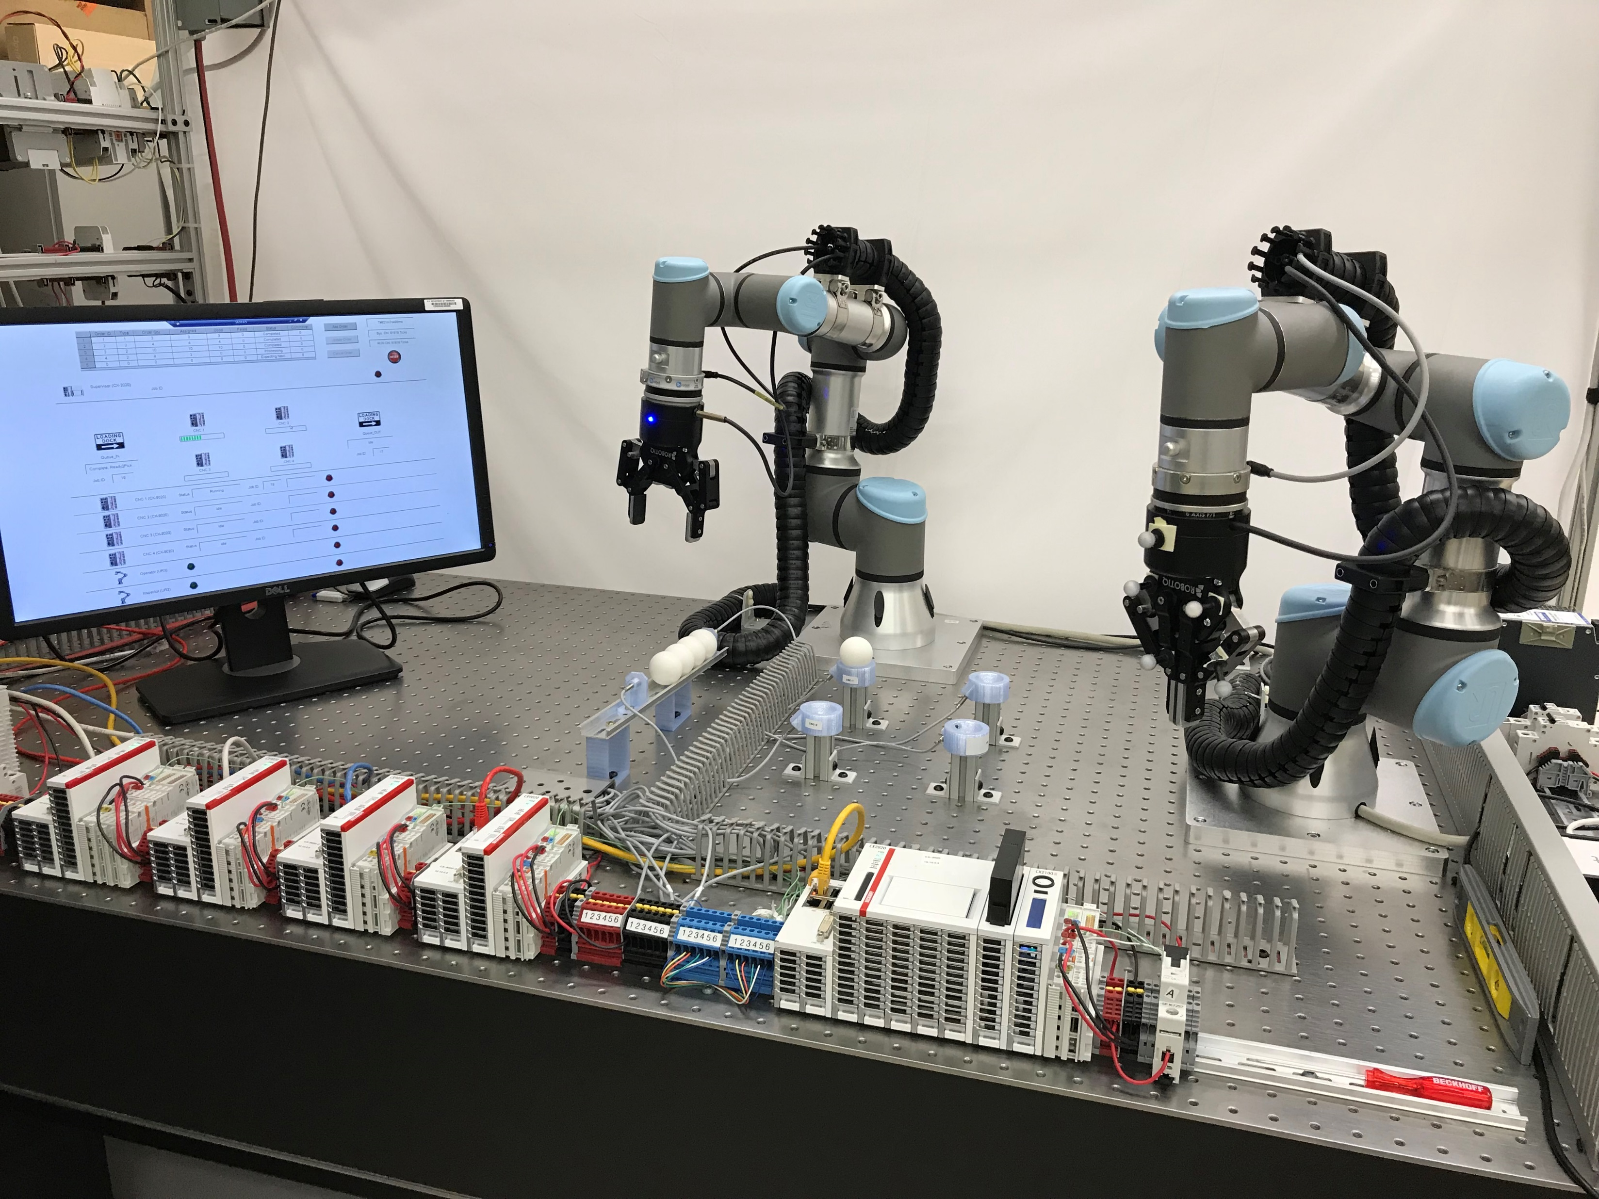
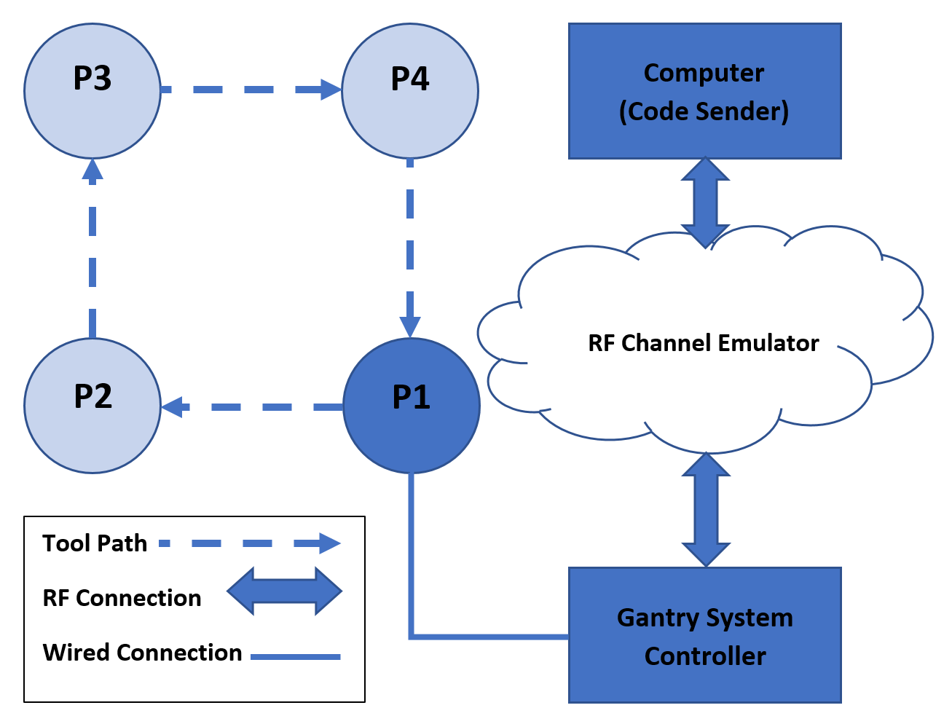
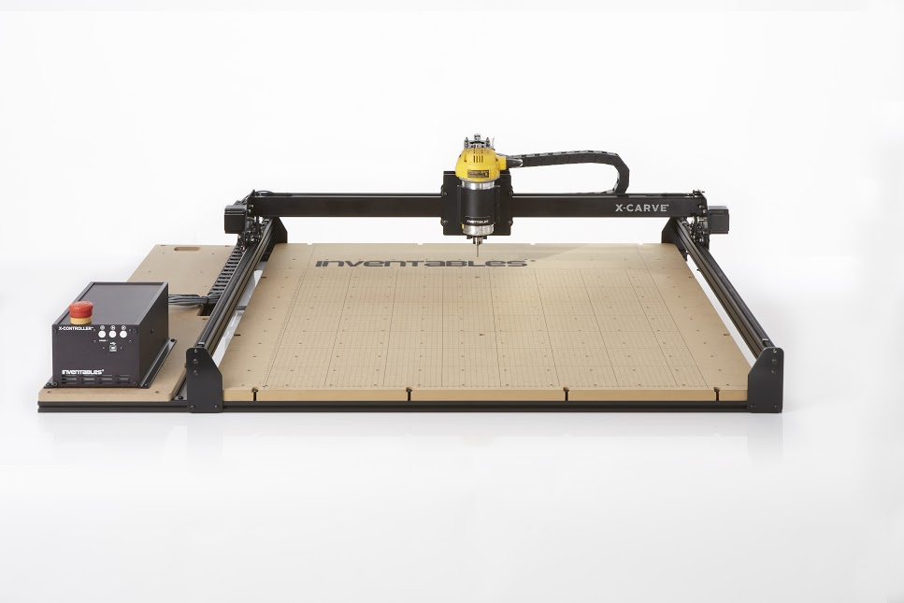
Testbed Implementations
(1)
1 - NIST - Tennessee Eastman chemical plant
2 - NIST - 3D gantry system
* 3 - NIST - Force seeking apparatus
* 4 - NIST - Dual-robot machine tending with inspection
(2)
(3)
(4)

Slide 7
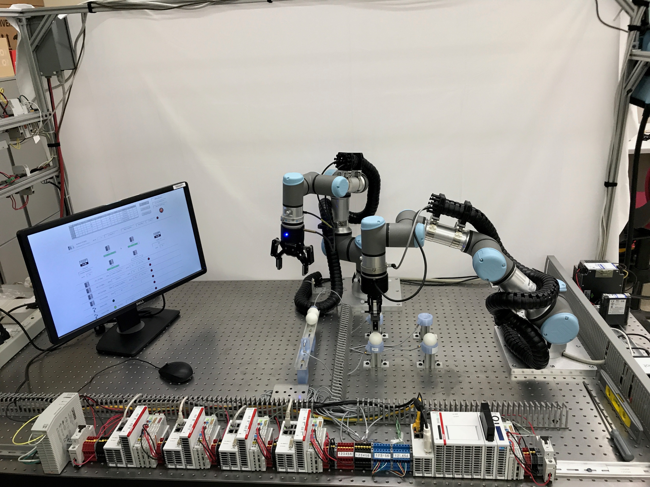
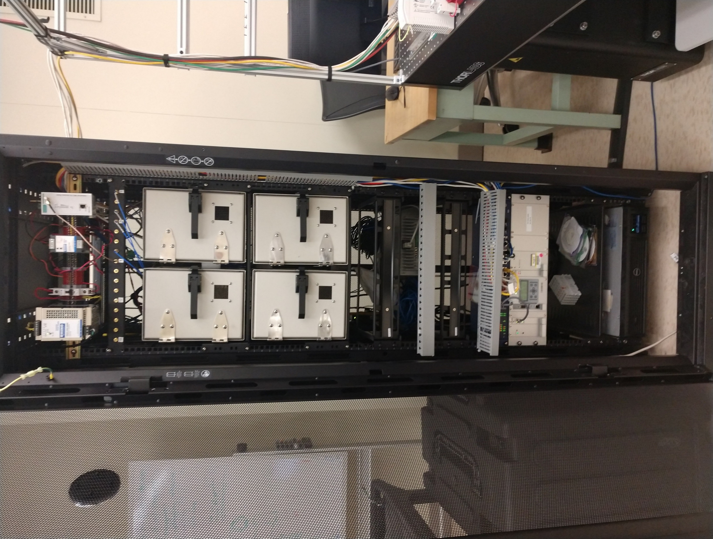
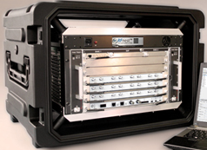
Experimental Testbed for Graph Database and SysML Work
Dual Cobots
RF
Shielding
CNC Sims
Supervisor
IEEE 1588 Master
RF Channel Emulator
TSN Capable

Slide 8
Thesis Motivation
Discover practical test and evaluation methods for assessing performance of an industrial workcell thereby enabling control systems implementers to adopt and improve wireless deployments.

Slide 9
Research Objectives
Exploration of Requirements:
Understand industrial wireless user requirements space
Remove hype due to marketplace and speculation
Provide validated requirements
Architectural Decomposition:
Decompose the factory workcell into components, interfaces, and information flows
Identify constraints affecting cyberphysical performance
Make the resulting finding reusable and publicly accessible
Discovery by Prototyping:
Use data from real-world experiments to drive research
Non-traditional Analysis:
Apply learning algorithms to explore data resulting from experimentation
Produce novel methods that can help identify problems during operation
Notes:
Exploration of Requirements: Industrial applications vary widely depending on the needs of the application. Applications may range from Condition Monitoring (CM) in which the required reliability and tolerable latency is high to applications such as hard real-time applications for safety integrated systems (SIS) in which reliability and latency are strictly controlled. Much of the information regarding communications requirements of these widely varying applications are based on opinion with little validation specified. Moreover, the information found can be confused by media hype and speculation. Therefore, a very important and first step in the research was to explore the requirements as stated by reputable sources such as international standards organizations and peer-reviewed papers and provide a distilled, realistic perspective uncluttered by hype and supported by experimental data or analysis of the underlying use cases.
Architectural Decomposition: The next important element within the research was to understand the composition of a factory workcell to include its constituent parts and interfaces. The goal in doing so was to discover and model the important CPS elements of a factory workcell and how those elements connect, interrelate, and conduct information in a general sense. Therefore, our objective was to create a reusable exploratory model of the CPS that is a factory workcell in which wireless communication is the primary mode of communication.
Discovery by Prototyping: During the discover process of the research work, we aimed to perform our research using real-world data from physical experiments. Since the required resources were available and at our disposal, our research objective was to conduct as much of the research using actual devices such as industrial automation and communication equipment as possible.
Non-traditional Analysis: Our final goal was to explore through experimentation the use of new data organization methods and learning approaches to analyze data taken from laboratory experiments. Therefore, our research objective was to apply database technology and machine learning algorithms in ways that had not yet been adopted or used for analysis of CPS performance analysis.

Slide 10
Introduction to Cyberphysical Systems in Smart Manufacturing
Thesis Context
Introduction to Cyberphysical Systems in Smart Manufacturing
Industrial Wireless Requirements
SysML: Workcell Architectural Decomposition and Analysis
Application of the Graph Databases to CPS Experiments
Machine Learning in a Robotic Force Seeking Application
Conclusion
Performance Estimation, Testing, and Control of Cyber-Physical Systems Employing Non-Ideal Communications Networks
Thesis Presentation 28 September 2020
Richard Candell

Slide 11
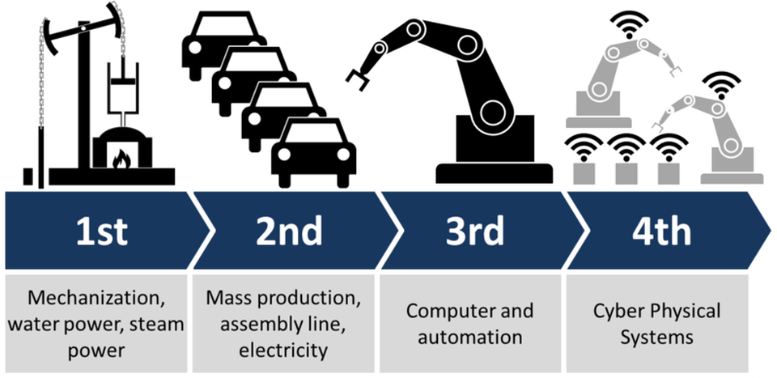
History of World Industrialization
Notes:
There have been four major industrial revolutions since industrialization began more than 200 years ago.
Gen 1: Steam engines powered by coal - late 1700’s
Gen 2: Powered by electricity and manned by people - late 1800’s
Gen 3: Computers are added to automate most of the process - later part of 1900’s
Gen 4: Use of data and intelligence to improve agility of the process – ENTER the CPS - 2000’s and today

Slide 12
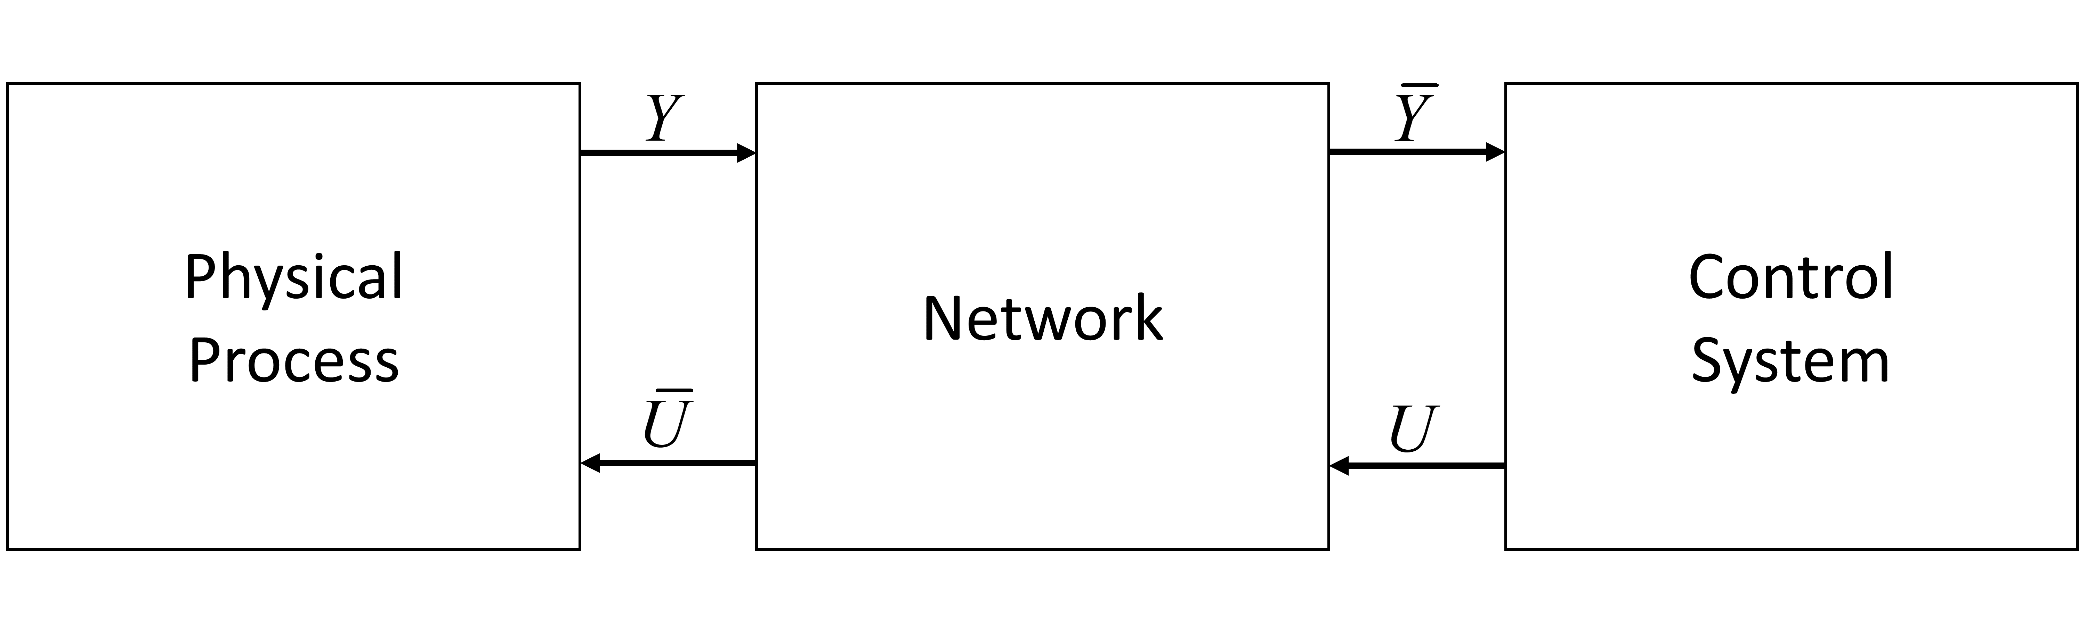
What is a Cyber-physical System? (CPS)
Operational Technology (OT)
Information Technology (IT)
Notes:
Definition most applicable for this thesis: A CPS is a physical process that is highly connected through computing devices such as sensors, actuators, and controllers.
A cyberphysical system (CPS) is a computer system in which a mechanism is controlled or monitored by computer-based algorithms. In cyber-physical systems, physical and software components are deeply intertwined, able to operate on different spatial and temporal scales, exhibit multiple and distinct behavioral modalities, and interact with each other in ways that change with context.^{[1]} Examples of CPS include smart grid, autonomous automobile systems, medical monitoring, industrial control systems, robotics systems, and automatic pilot avionics.^{[2]}

Slide 13
CPS Concepts in Smart Manufacturing
Situationally-aware and state-aware automation systems
Intelligence closer to the edge devices (or in the devices)
Better test methods that include holistic perspective
Better communications protocols (esp. for wireless)
Requires high reliability and security
Notes:
The automation system must become state aware and adaptive to knowledge of the trends in electromagnetic spectrum occupancy and acute events;
Intelligence of the automation system must move closer to the physical system. This means moving the intelligence for control to the actuator; and
Performance test methods must be developed and incorporated into the industrial fringe devices. The test methods must be dependable and at the same time easy to use by factory personal not trained in the technicalities of wireless communication.
Existing Wireless communications protocols must be analyzed and adapted, and new protocols must be developed to balance reliability, latency, and scalability.
Security of the network must be maintained and must include availability as a paramount characteristic.

Slide 14
Industrial Wireless Requirements
Thesis Context
Introduction to Cyberphysical Systems in Smart Manufacturing
Industrial Wireless Requirements
SysML: Workcell Architectural Decomposition and Analysis
Application of the Graph Databases to CPS Experiments
Machine Learning in a Robotic Force Seeking Application
Conclusion
Performance Estimation, Testing, and Control of Cyber-Physical Systems Employing Non-Ideal Communications Networks
Thesis Presentation 28 September 2020
Richard Candell

Slide 15
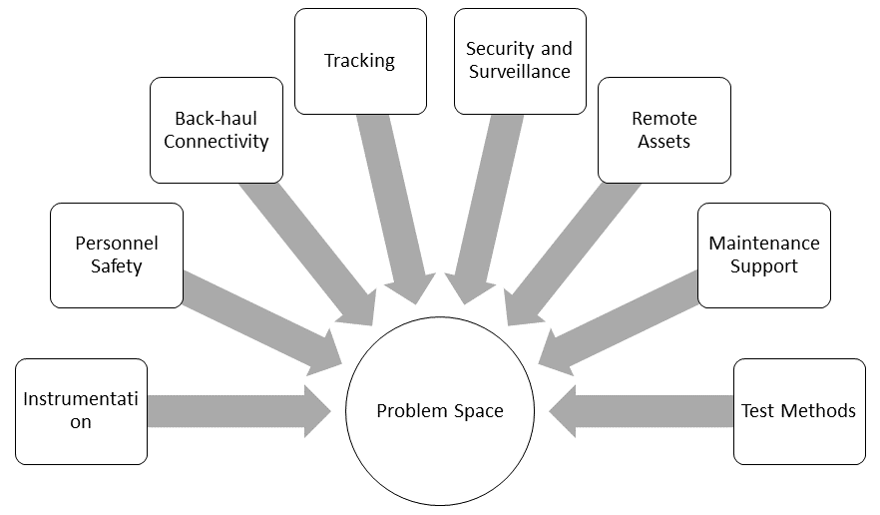
Analysis of Wireless User Requirements
Problem Space Evaluation
Requirements Sources:
NIST IWS Technical Working Group
Two (2) IEEE IES Workshops
ISA 100 User Requirements
ETSI Report TR 103 588
Academic papers
Outputs
Mapping of existing wireless technology to cover requirements
New consolidated requirements report by NIST
Notes:
ISA-TR100.00.03-2011 Wireless User Requirements for Factory Automation
ETSI, “ETSI TR 103 588 - Reconfigurable Radio Systems (RRS); Feasibility study on temporary spectrum access for local high-quality wireless networks,” 2018. [Online].

Slide 16
Mapping Wireless to Use Cases
Flow-based
Job-based
Safety
Back-haul
Tracking
Security
Remote Control
Maintenance
Notes:
Considered many different types of industrial use cases
Considered how each wireless technology could be applied, if they could be applied and to what degree
Used literature to support our claims.

Slide 17
Our Perspective on Wireless User Requirements
User Requirement |  | Class 0: Safety | Class 1: Closed Loop Regulatory Control | Class 2: Closed Loop Supervisory Control | Class 3: Open Loop Regulatory Control | Class 4: Alerting and Monitoring
Latency (ms) | Typical | 4 | 4 | 20 | 4 | 50
 | Minimum | 0.5 | 0.25 | 4 | 0.5 | 4
Reliability (Pr. of Loss) | Typical | 10⁻⁷ | 10⁻⁷ | 10⁻⁷ | 10⁻⁷ | 10⁻⁶
 | Minimum | 10⁻⁷ | 10⁻⁷ | 10⁻⁷ | 10⁻⁷ | 10⁻⁷
Scale (# of links) | Typical | 8 | 10 | 10 | 1 | 100
 | Maximum | 16 | 30 | 30 | 4 | 300
Range (m) | Typical | 10 | 10 | 10 | 10 | 10
 | Maximum | 30 | 30 | 30 | 30 | 30
Payload (B) | Minimum | 6 | 8 | 8 | 8 | 12
 | Maximum | 24 | 1024 | 1024 | 1024 | 33K
Update Rate (Hz) | Typical | 125 | 125 | 25 | 125 | 10
 | Maximum | 1000 | 2000 | 125 | 1000 | 125
K. R. Montgomery, R. Candell, Y. Liu, M. T. Hany, "Wireless User Requirements for the Factory Workcell" Advanced Manufacturing Series, NIST AMS 300-8, October 2, 2019

Slide 18
SysML: Workcell Architectural Decomposition and Analysis
Thesis Context
Introduction to Cyberphysical Systems in Smart Manufacturing
Industrial Wireless Requirements
SysML: Workcell Architectural Decomposition and Analysis
Application of the Graph Databases to CPS Experiments
Machine Learning in a Robotic Force Seeking Application
Conclusion
Performance Estimation, Testing, and Control of Cyber-Physical Systems Employing Non-Ideal Communications Networks
Thesis Presentation 28 September 2020
Richard Candell

Slide 19
Modeling Approach
Decompose the industrial wireless workcell into:
Constituent components
Identify interfaces
Identify information flows
Identify constraints to performance
Construct a re-usable model for other researchers
Help improve the understanding of the industrial wireless workcell
Communicate designs more effectively
Make model publicly available

Slide 20
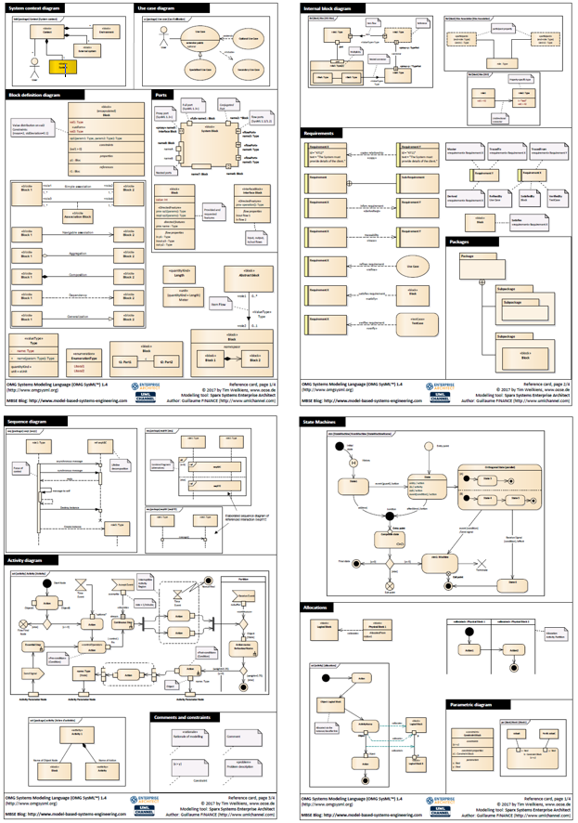
SysML Primer
SysML Components
Blocks, Ports, Connections, Associations
Popularly Used Diagrams
Block Definition Diagrams (BDD)
Internal Block Diagram (IBD)
Parametric diagram (PAR)
Use case diagram (UC)
Requirements diagram (REQ)
Package diagram (PKG)
Other diagrams
Reference card taken from:
https://community.sparxsystems.com/community-resources/1043-sysml-1-4-reference-card
Notes:
BDD – shows context and decomposition
IBD – shows the internal construction of a block
PAR – shows how a block is parameterized or constrained by values, equations, and logic (programs)
UC – shows use cases of a system
REQ – captures requirements
PKG – Shows package organization
Other diagrams include
Sequence diagrams
Activity Diagrams
State machines

Slide 21
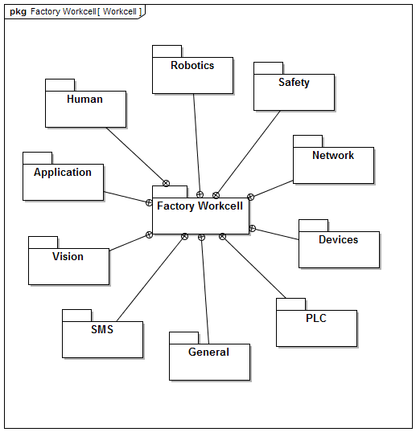
Packages
Package:
Logical encapsulation of blocks and diagrams within a model
Components:
General: contains key reusable blocks for constructing other packages
Devices: describes the generic device blocks within the model
Network: describes the generic industrial network
Robotics
PLC: Programmable Logic Controller
Safety
SMS: Spectrum Monitoring System
Notes:
SMS is a key component of any industrial wireless deployment

Slide 22
Conceptual Block Diagram
Notes:
Applications are contained within a Device to describe its use and contain programs

Slide 23
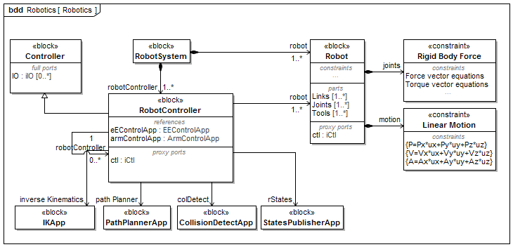
Robotics – Sample BDD

Slide 24
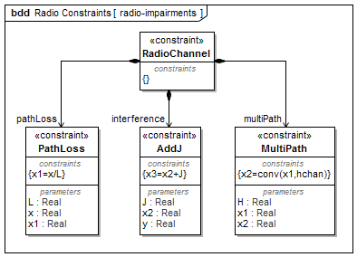
Constraints
Allows us to model mathematically or programmatically effects of behavior within a block.
Types of Constraints:
Radio Channel
Motion
Data (i.e., Network)

Slide 25
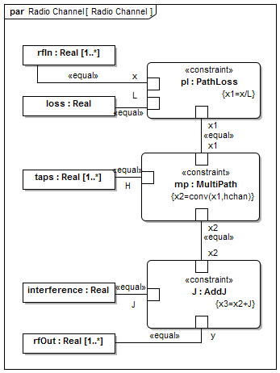
Radio Channel Constraints Implementation

Slide 26
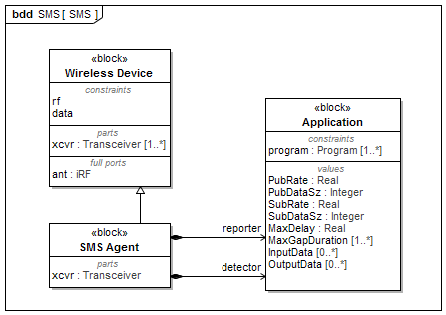
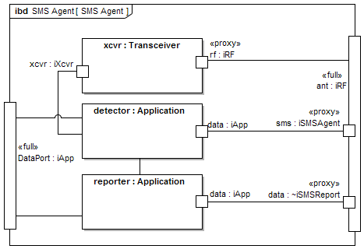
Spectrum Monitoring System (SMS)

Slide 27
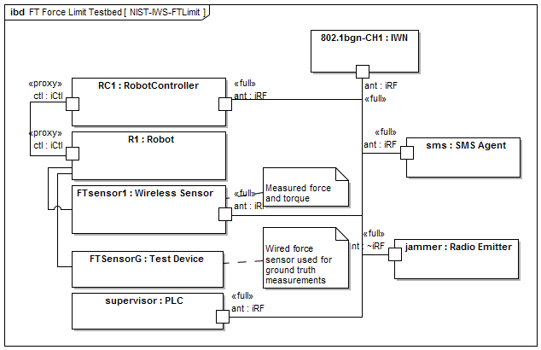
Sample IBD of a Workcell
Similar to the force limiting apparatus used for the machine learning research work presented later.

Slide 28
Application of the Graph Databases to CPS Experiments
Thesis Context
Introduction to Cyberphysical Systems in Smart Manufacturing
Industrial Wireless Requirements
SysML: Workcell Architectural Decomposition and Analysis
Application of the Graph Databases to CPS Experiments
Machine Learning in a Robotic Force Seeking Application
Conclusion
Performance Estimation, Testing, and Control of Cyber-Physical Systems Employing Non-Ideal Communications Networks
Richard Candell

Slide 29
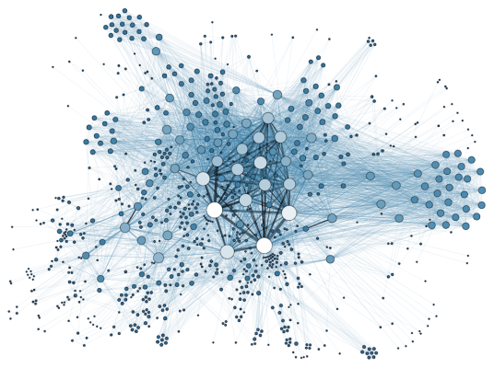
Introduction & Motivation
Motivation
Address the difficulty of organizing IT and OT data and their correlated relationships
Make access to the data and intrinsic correlations easier to discover
Graph Database Advantages
Inherently capture data and relationships
No need to perform complex joins
Outputs
Used the GDB to study the impacts of the network on the physical system
General approach to be widely used in industrial applications
Notes:
Lots of data from experiments:
GBs of data from a single experiment
Enormous amounts of data
Need to organize the data well
Neo4J chosen:
Free – no cost
Supports Python
Good reviews - seems to be the most popular

Slide 30
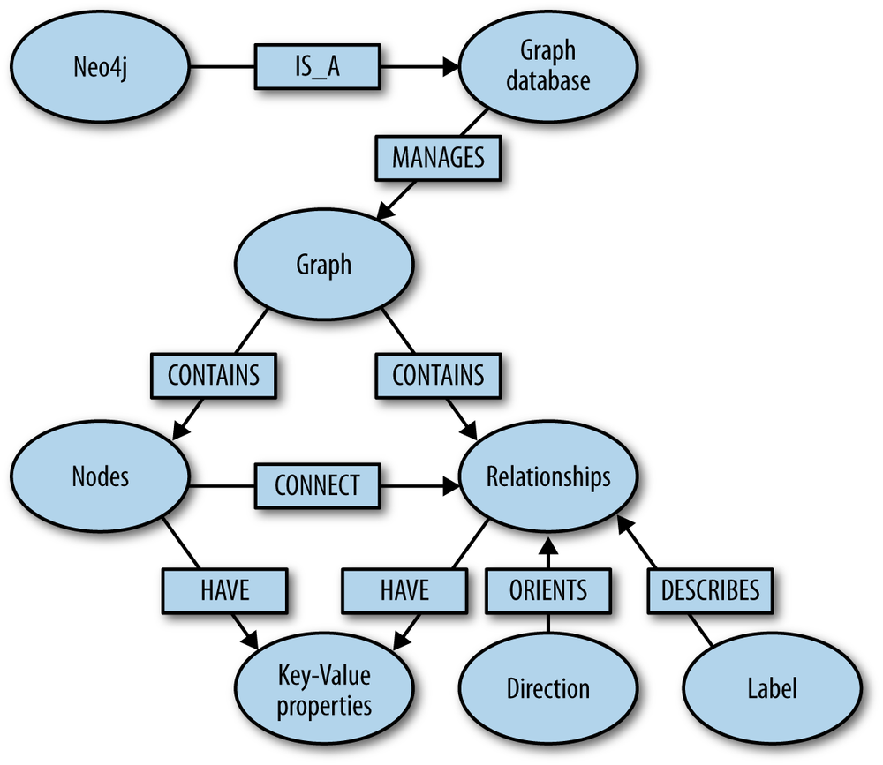
What is a Graph Database?
A graph database (GDB) is a database that uses graph structures for semantic queries with nodes, edges, and properties to represent and store data. A key concept of the system is the graph.

Slide 31
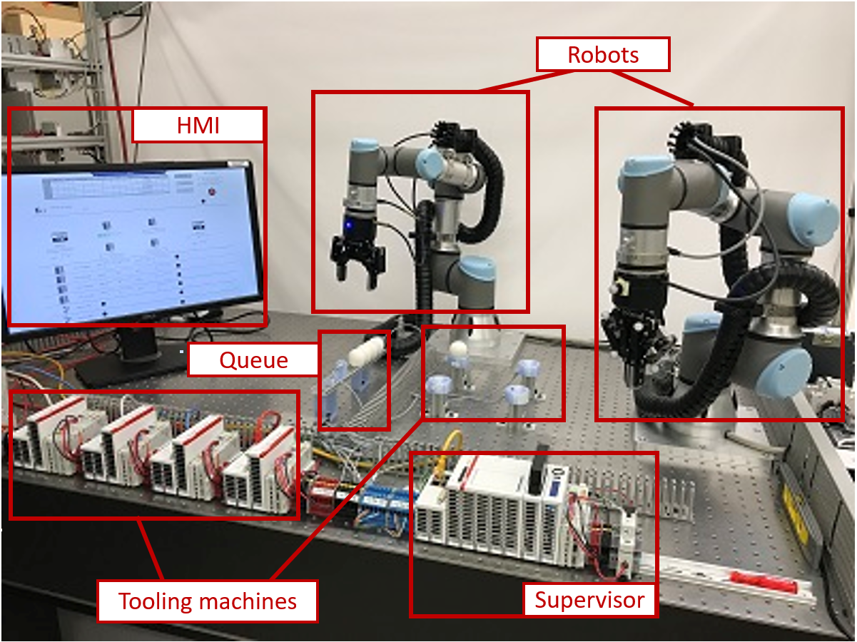
Testbed Configuration

Slide 32
Graph Database Process Flow
Notes:
Post-import tuning: Applies the timing information of the messages with the Wi-Fi sniffer reports to connect QoS reports with the messages. This is used to form the COVERED relationship. Python was used to process the CSV export and add new relationships to the database for existing nodes.

Slide 33

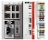
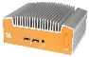
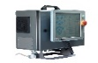
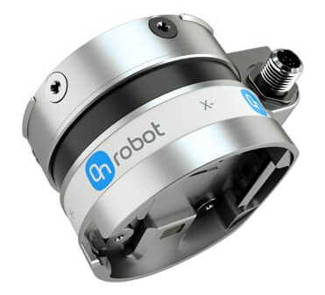
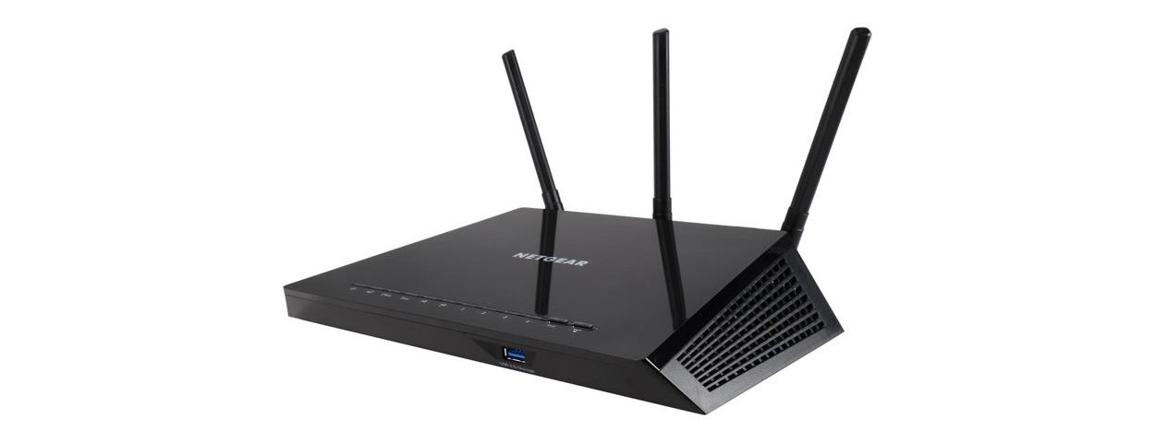
Data Collection Network Diagram
Inspector
Supervisor
NUC
INS_FT
INS_RC
TAP
Eth->Wi-fi
PLC
Two PTP capable switches
(22 ports combined)
Wi-Fi Router
Non-PTP Switch
TAP
AP
Robot Controller(RC)
Force-Torque(FT) Sensor
Operator
TAP
TAP
CNC_1
Non-PTP Switch
Eth->Wi-fi
Traffic Generator
Sniffer
Traffic Sink
TAP
CNC_2
TAP
CNC_3
OPT_FT
OPT_RC
TAP
CNC_4

Slide 34
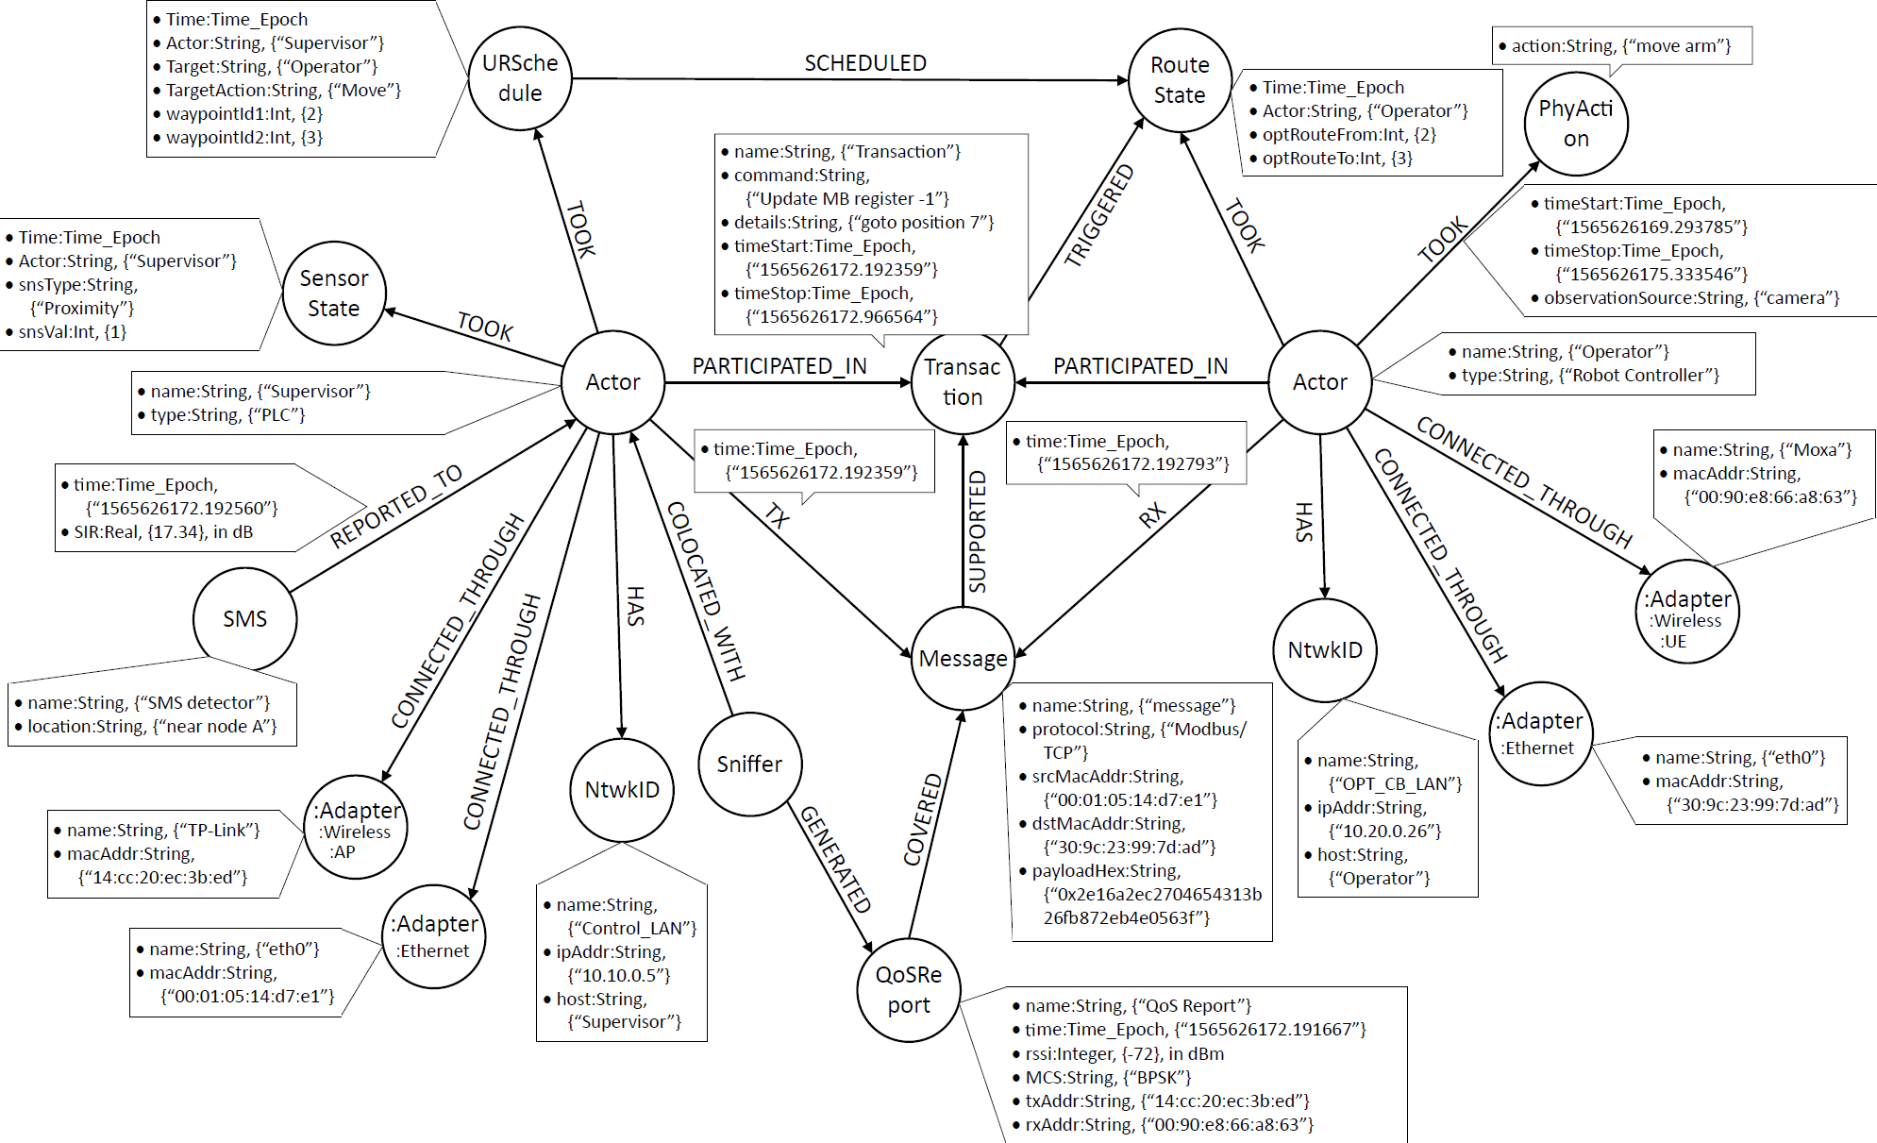
Schema Design Illustration
Notes:
Done using arrow tool on Internet
Really a “pseudo-schema” showing the intended design.
Actor
Transaction
Message
Network interfaces
Physical Action
URSchedule – PLC makes a decision
Route State – UR begins the movement/action
FROM PAPER
Transaction A complete information exchange between two or more actors (multiple actors may participate in a transaction).
Message A network transmission event that occurs between two actors (messages are essentially packet transmissions captured at the transport layer; multiple messages support a transaction).
QoSReport Quality of service report of a message (not all messages will have a QoS report).
Physical Action (PhyAction) A physical occurrence within the factory work-cell associated with Actors through multiple time-based relationships.
PhyAction:URSchedule A subcategory of PhyAction representing a schedule decision made by the supervisor PLC for a robot
PhyAction:SensorState A subcategory of PhyAction representing a real-time reading of the proximity sensor state in a CNC
PhyAction:RouteState A subcategory of PhyAction representing a real-time reading of the action route in a robot

Slide 35
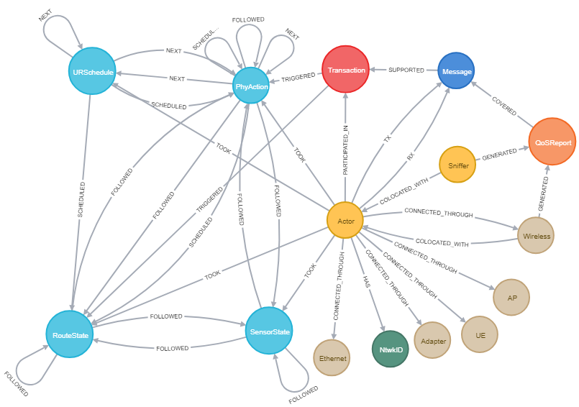
Realized schema: Only the visualization is different from designed schema
Notes:
Does not show inheritance in the realized graph.
call db.schema.visualization()
One thing that I don’t like is that it does not display the inherited node types although they do exist in the GDB, they are not shown in the visualization.

Slide 36
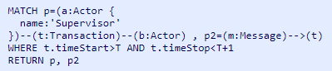
Example Query Using Cypher
This query searches for all Supervisor-based Transactions and associated Messages where the Transaction start and stop times fall within the first second of the experiment.
The query will return the Supervisor node with connected messages.

Slide 37
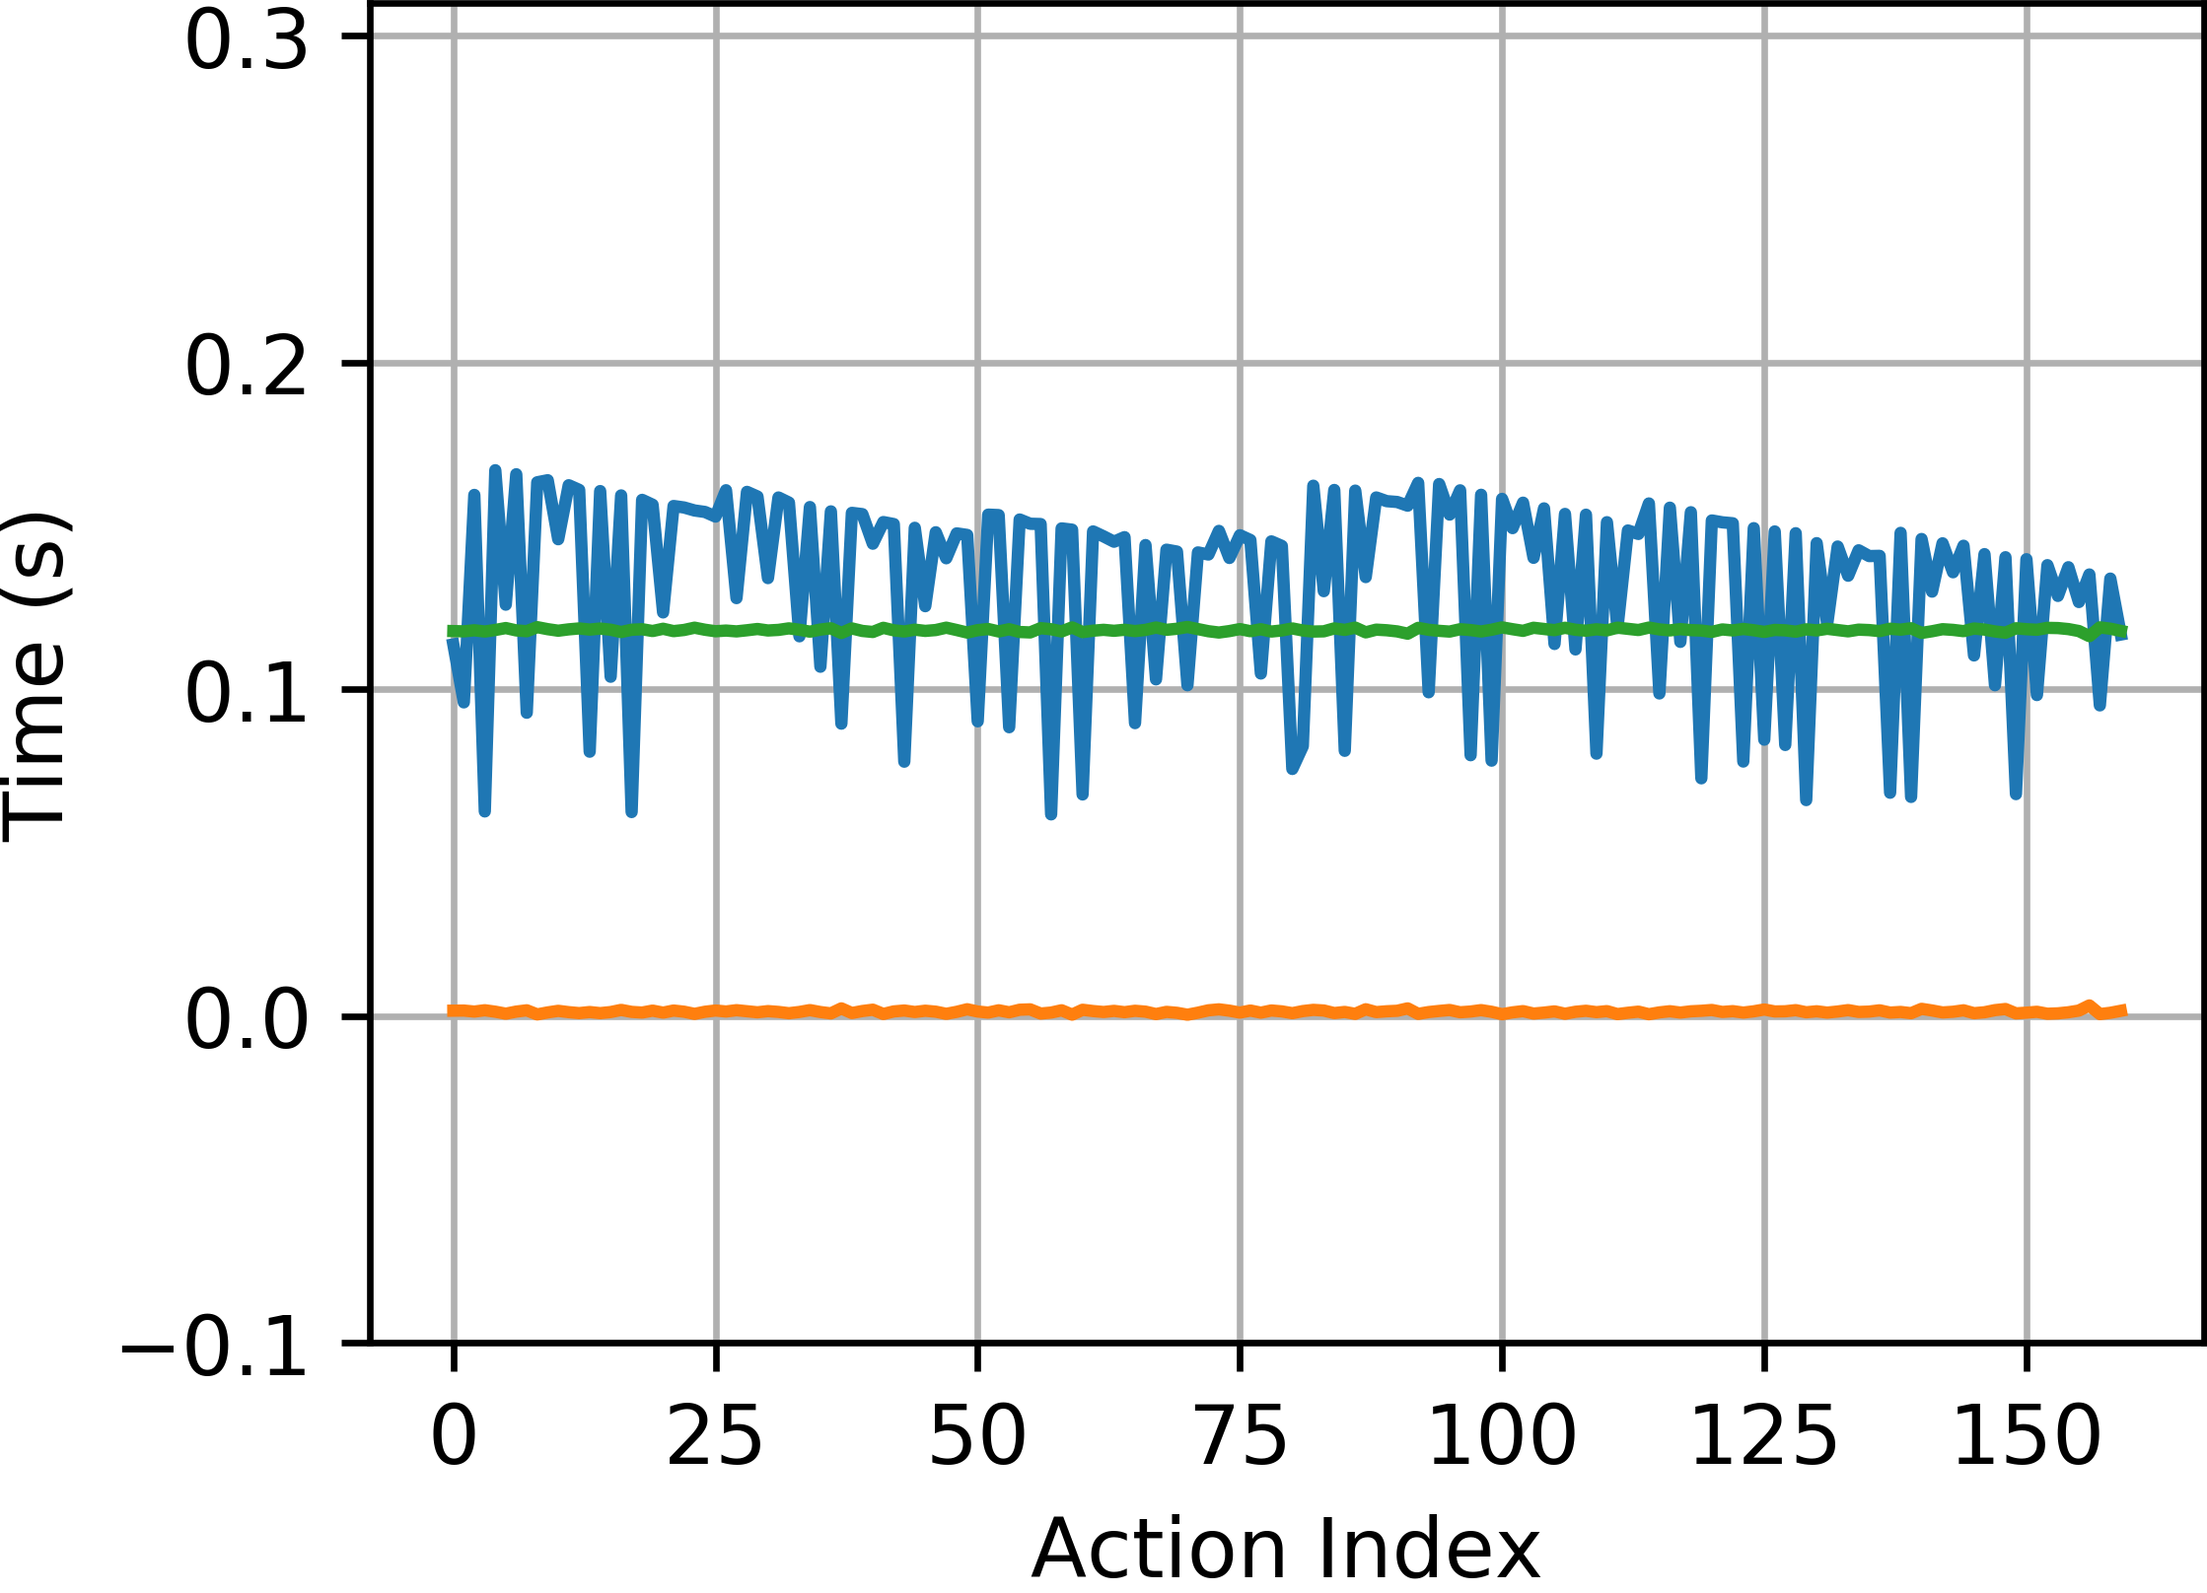
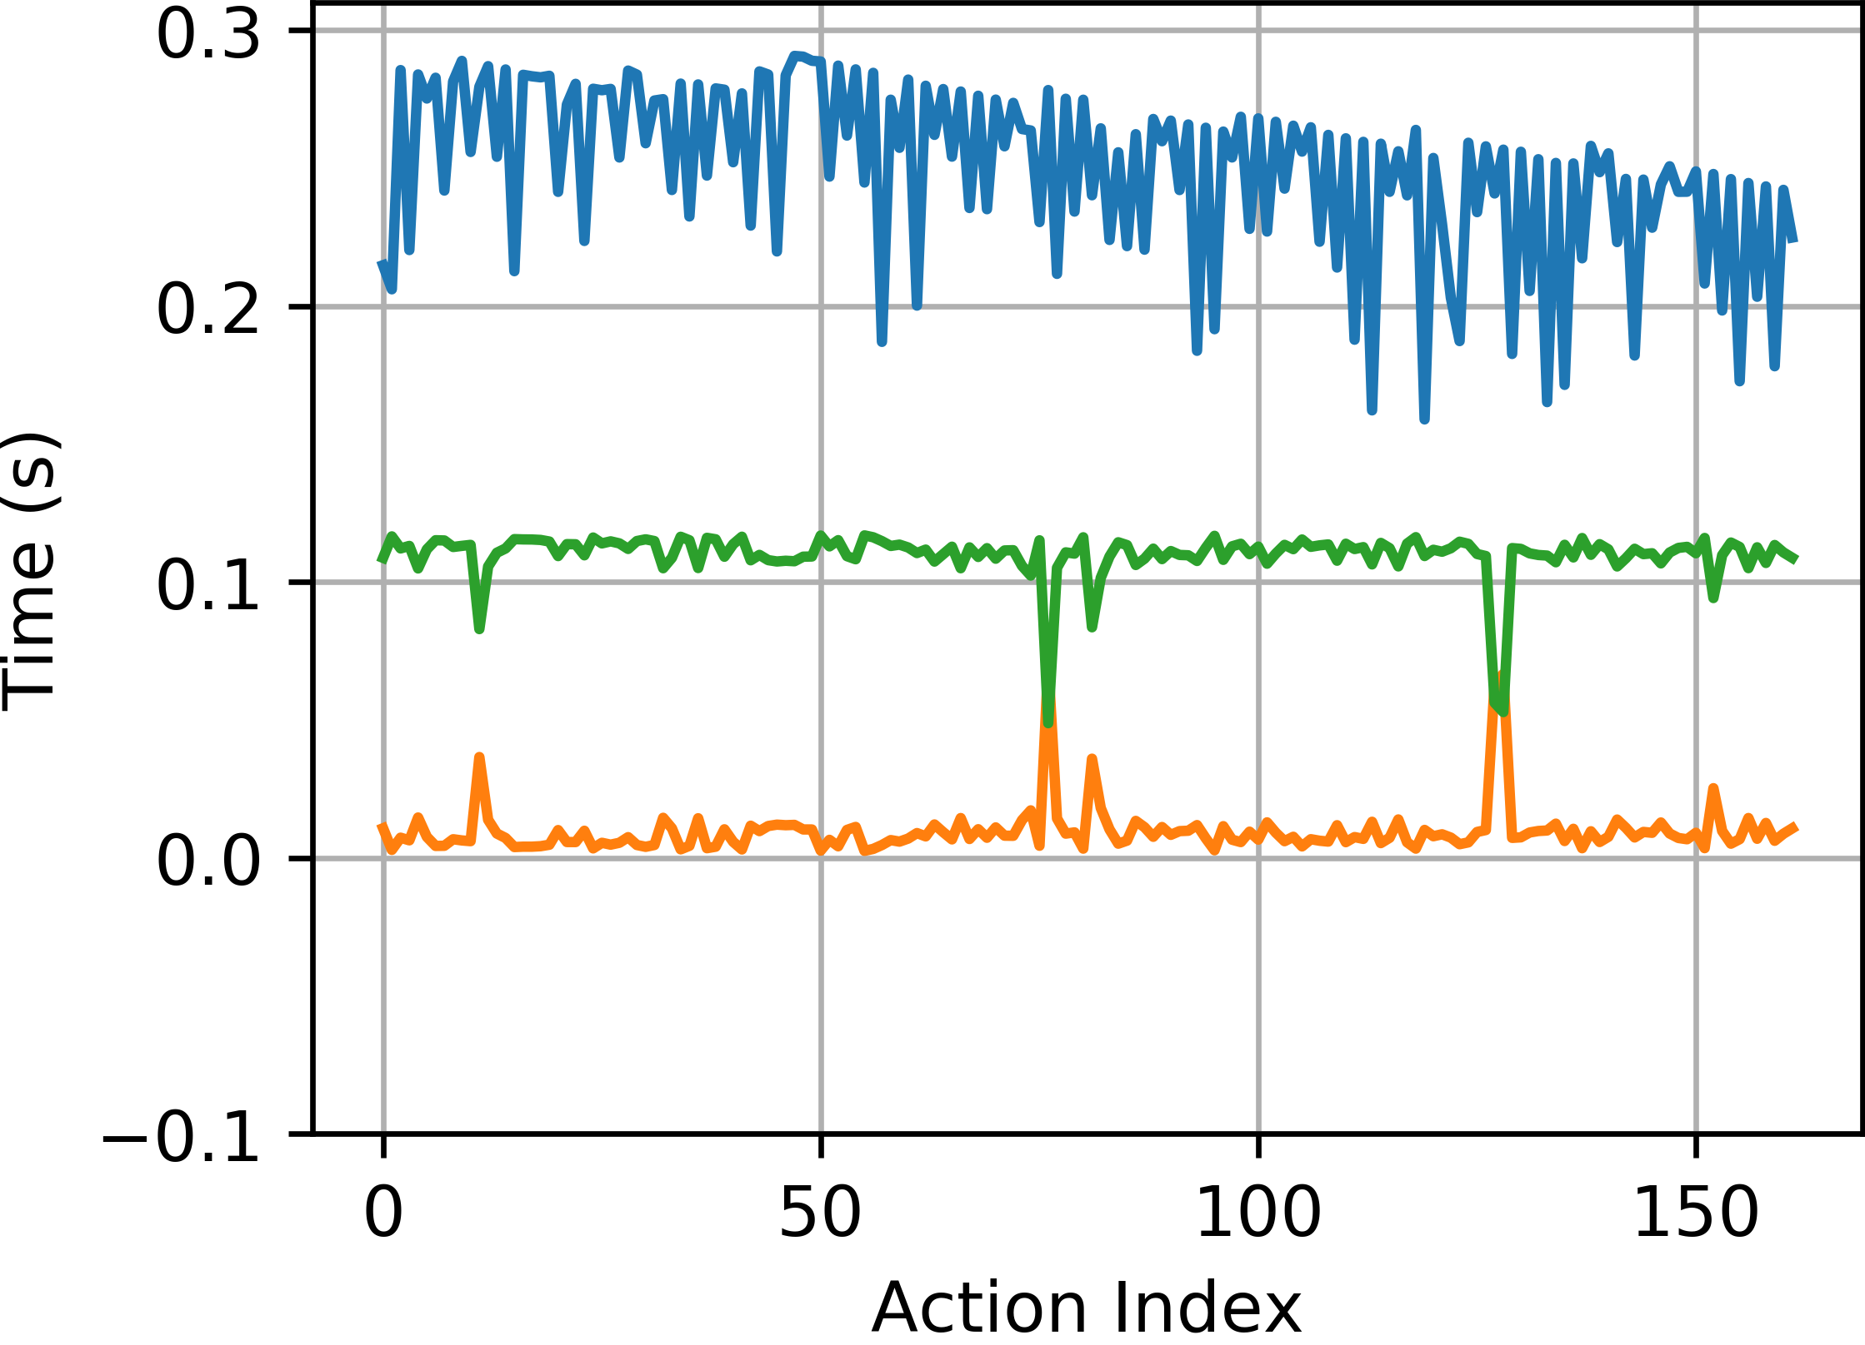
Sample Results from Query
Latencies - Wired Baseline
Latencies – Wireless with
2-Streams of Interference
Latency Performance – delay of an action, information, etc. through a system.
The supervisor PLC processing time shown in blue.
The transaction latency shown in orange is clearly impacted by the wireless channel.
Time to act by robot control in green appears to compensate for transaction latency.
Notes:
Blue line variation seems unconnected to the network but entirely dependent on the processing within the PLC
Orange and Green sum to be constant at 120 ms which is loop rate of the robot controller. Wait time in the robot controller included a 20 ms intrinsic loop time plus another 100 ms hard-coded wait time.
Average processing time of the PLC did increase with the wireless baseline due to a programming change to accommodate longer ADS protocol delays in communication.

Slide 38
Machine Learning in a Robotic Force Seeking Application
Thesis Context
Introduction to Cyberphysical Systems in Smart Manufacturing
Industrial Wireless Requirements
SysML: Workcell Architectural Decomposition and Analysis
Application of the Graph Databases to CPS Experiments
Machine Learning in a Robotic Force Seeking Application
Conclusion
Performance Estimation, Testing, and Control of Cyber-Physical Systems Employing Non-Ideal Communications Networks
Thesis Presentation 28 September 2020
Richard Candell

Slide 39
Introduction and Motivation
Goals
Predict link quality indirectly using measurements of the OT (physical) system
Eliminate the expense of RF equipment for LQE measurement in the factory
Results
Measured LQE using measurements data from vision system measuring the movement of a robotic arm depressing a spring
Accuracy of LQE prediction within ±0.5 dB
General approach to estimation of link quality in automation systems.
Notes:
Used the Scikit-Learn Python library for implementation

Slide 40
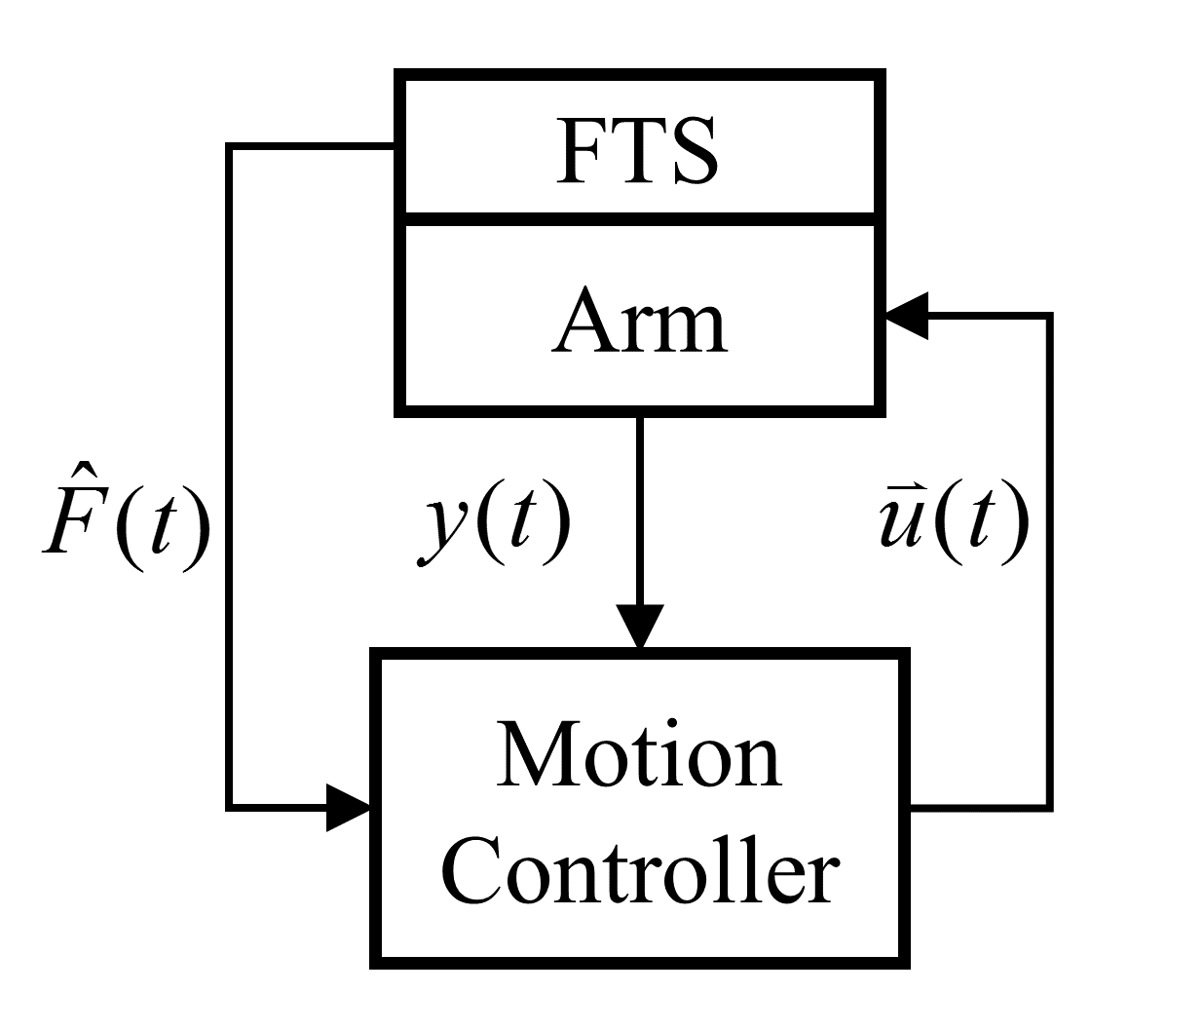
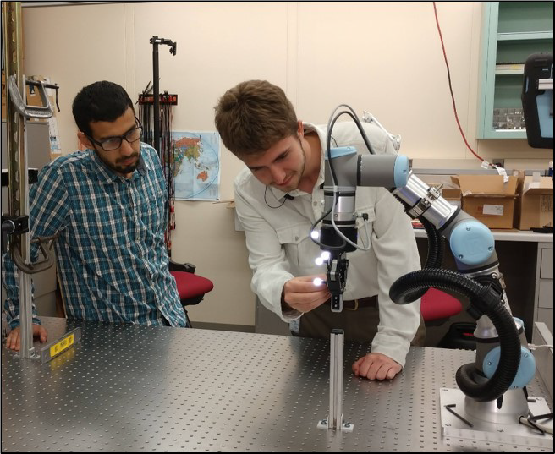

Model of the Feedback Control System
Vision system targets

Slide 41
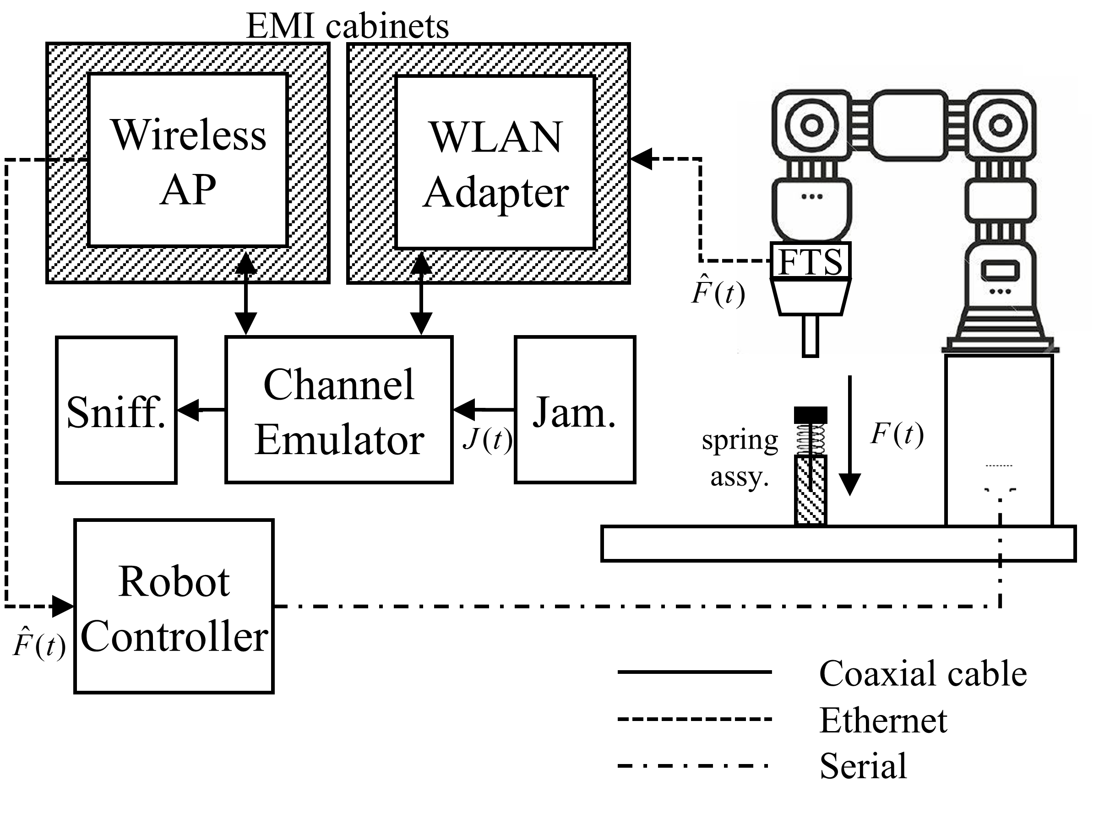
Force-seeking spring system apparatus
Robot depresses a spring until a force of 5 N is sensed
Force is monitored by a wireless force-torque sensor (FTS)
Emulator is used to control the effect of a local jammer
Wireless sniffer is used to monitor network traffic traversing space

Slide 42
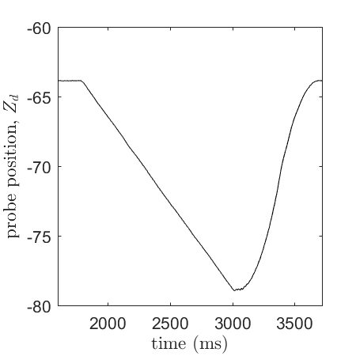
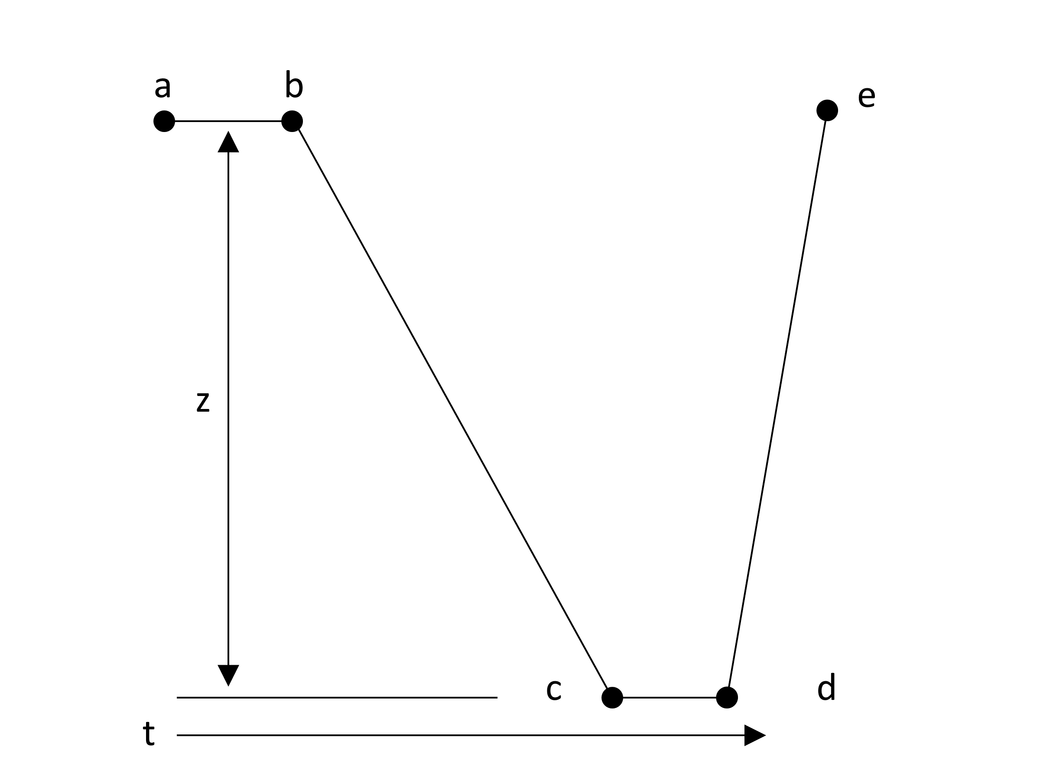
Time-Series Feature Extraction Model
Sample Data
of Arm Movement
Robot Arm Movement Model
For Single Cycle
For future reference, M is the number of these feature sets combined to make a single training vector.
Notes:
Classic way of dealing with time series data
* Extract features RATHER than using the time series directly

Slide 43
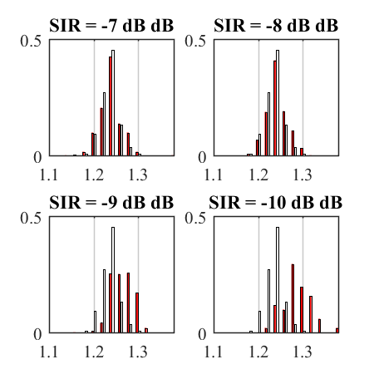
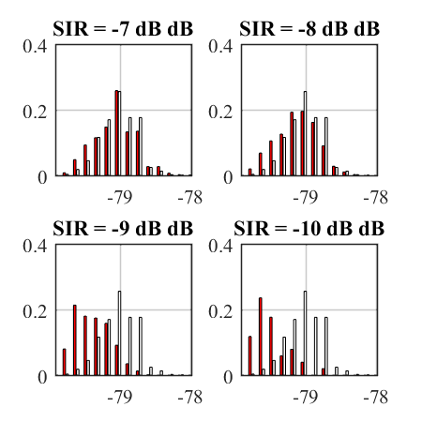
Learning candidacy statistics
Z_{bc} Plunge Time
Z-axis Deflection
White bars are WIRED
Red bars are WIRELESS

Slide 44
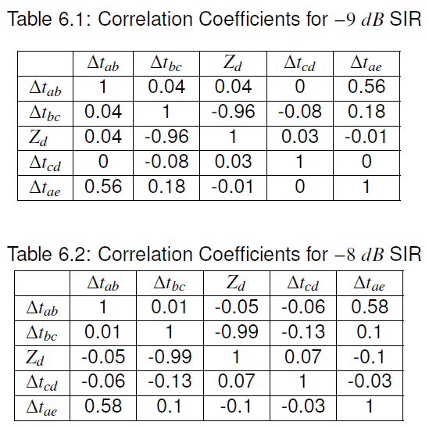
Feature Independence Check
Verification of non-correlation between features. Features work best in ML when they are mostly independent. A first look shows that the features are mostly independent from one another. This does not mean that each one has importance, but rather they will not interfere or be redundant.
Notes:
Zd and DeltaTbc are correlated because D = Velocity * T
Correlation of Delta-Tab and total time are strongly correlated because only Delta-Tab is most affected by SIR (later revealed in second paper due to time of zeroing).
Zeroing accomplished by messaging between RC and the Compute box to zero-out sensor. This message gets delayed by lower SIR’s.
Correlation 0 indicates not correlated
Correlation of +1 or -1 indicates a very strong correlation either positively or negatively.

Slide 45
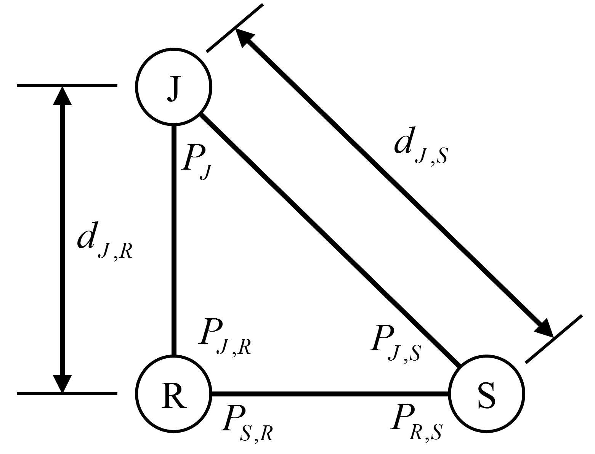
Model for Radio Path loss and Interference Emulation
Vary distance between jammer and router
Vary distance between jammer and station
Changing the mode of the router

Slide 46
Prediction Performance – Random Forest
Notes:
M is the number of cycles used for a single training record
M is the number of these feature sets combined to make a single training vector.

Slide 47
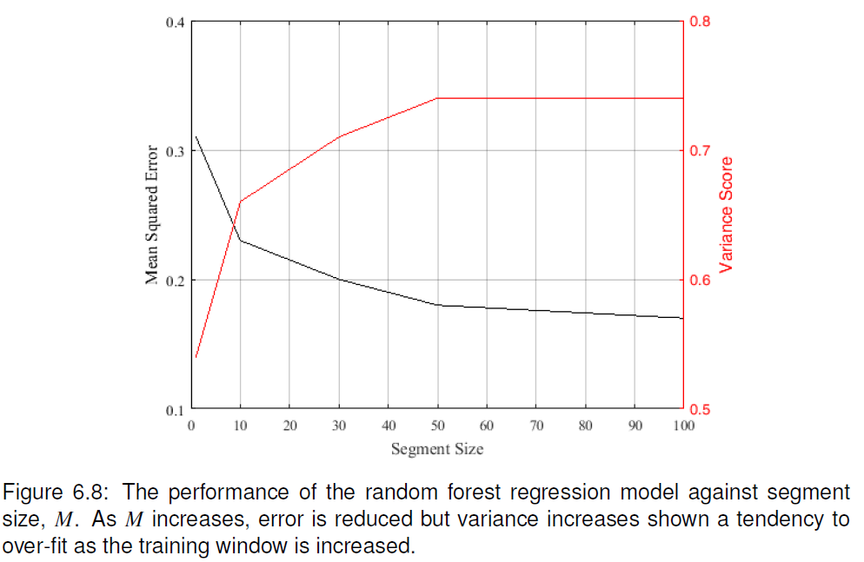
Results Against Segment Size, M
Notes:
MSE: Is the mean squared error
Variance: Is the actual R-squared value. +1 is the best score. 0 means estimating variance of process. -1 means that error variance is more than process variance.
Variance SCORE going up means better but takes more time
Good explanation found at http://rasbt.github.io/mlxtend/user_guide/evaluate/bias_variance_decomp/#:~:text=Then%2C%20the%20bias%20is%20commonly,%5B%CB%86%CE%B8%5D%E2%88%92%CE%B8.

Slide 48
Subsequent Regressor Comparisons
Random Forest (RnF) – randomized decision regression trees are formed based on random, and a joint result from all trees are calculated. Overfitting is achieved by limiting leaves and features in each tree constructed although full coverage is guaranteed by the sheer number of trees constructed.
Gradient Boosting Machine (GBM) – Similar to RnF except that tree size is limited, and trees are iteratively made by minimizing the residual errors of the previous trees until convergence is achieved.
Extreme Gradient Boosting Machine (XGBM) – Like GBM but uses similarity score (mean sum error + regularization λ)
Linear Ridge – first-order linear regression model (as a comparison)

Slide 49
Variance and MSE of Various Regressors
Notes:
Bias: Difference between the expected value of the estimates and the actual values.
MSE: Is the mean squared error
Variance: How much the estimate varies around its own expected value

Slide 50
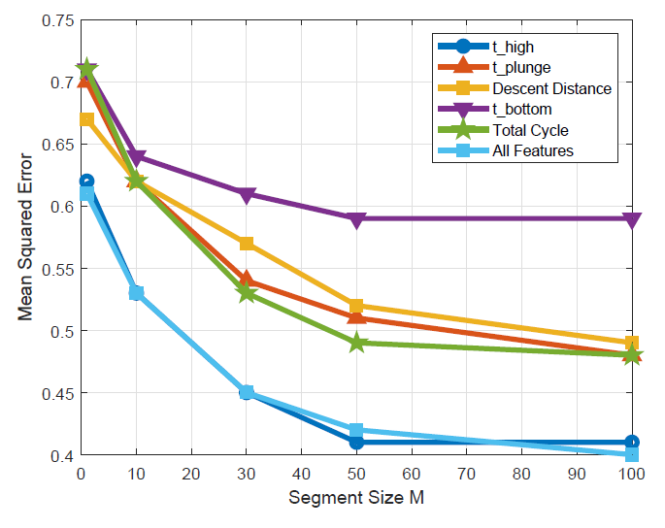
Comparison of Feature Importance
Using XGBM as basis
Comparison of impact of each feature one-at-a-time and then all together.
Dwell time before descent (Δt_{ab}) was found to be the most impactful feature
Due to zeroing message between robot controller and FT sensor compute box
Notes:
Reset value took longer

Slide 51
Conclusion and Future Direction
Thesis Context
Introduction to Cyberphysical Systems in Smart Manufacturing
Industrial Wireless Requirements
SysML: Workcell Architectural Decomposition and Analysis
Application of the Graph Databases to CPS Experiments
Machine Learning in a Robotic Force Seeking Application
Conclusion
Performance Estimation, Testing, and Control of Cyber-Physical Systems Employing Non-Ideal Communications Networks
Thesis Presentation 28 September 2020
Richard Candell

Slide 52
Conclusion
Requirements and Wireless Landscape
Surveyed the wireless technology landscape
Made the requirements realistic and validated
Modeling Approach
Produced a reusable model using SysML
Include both structure of the IWN and the Physical System
Graph Database Approach
Demonstrated use of a GDB for CPS performance evaluation
Use of GDB to reveal performance correlations between IT and OT
Machine Learning Approach
Use of decision trees to estimate link quality (SIR) using OT measurements
Notes:
What I have presented

Slide 53
Future Work
SysML
Modeling Enhancements
Integration with CPS simulation
Graph Database
Make the GDB real-time or near-real-time with on-the-go queries
Improve the GDB Schema to avoid Cartesian Product explosions
Machine Learning
Increase dimensionality of the machine learning approach to address considerations of larger systems and concerns
Integrate the machine learning approach with a control system to allow the control system to adapt to changes in the RF environment
Add spectrum monitoring system as an input to the machine learner
Notes:
SysML Modeling Enhancements Application of the model described may be improved upon and incorporated into \gls{cps} simulations. By using the model and associated constraints, it should be possible to use the blocks defined to parameterize the simulation variables. Additionally, moving beyond simulation which uses simulation to understand complex systems through empirical analysis, complete mathematical analytical models could be constructed if the fidelity of the \gls{sysml} model is sufficiently refined.
GDB Real-time Integrations A logical next step in applying \glspl{gdb} to \glspl{cps} is to move its application from a post-experiment analysis to a real-time analysis of a live system. Such an analysis could prove insightful in the prediction of factory workcell performance at near-real-time. Parallel data collection, cleaning, and insertion strategies could be considered. Further integration and feedback into the production system of information learned from real-time queries is possible to improve overall live performance of the factory.
GDB Schema Improvements During the experimentation with the Cipher query language, we found that some queries led to unusually large and intractable intermediate result sets which resulted in a computer crash regardless of the organization of the query statements themselves. This problem resulted from a Cartesian product explosion that was never sufficiently explained such that a resolution could be implemented. It was not clear if this was a result of normalization of the query within the Cipher interpreter or a result of the schema that we developed. Reorganization of our queries did not help to alleviate this problem which ultimately limited the usefulness of the \gls{gdb}. The use of \glspl{gdb} was nevertheless proven as it was an essential aid in organization of our very large \gls{cps} data sets produced from experimentation. For a scientist interested in such deep-dive questions related to database query languages or schema development, this would be an interesting problem.
ML Add More Dimensions Application of our ML framework to a system with more degrees of freedom such as the entire workcell. In our contributions, the ML framework was applied to a single wireless communication link used to control one robot arm. When expanded the framework to systems with more dimensions, the application of neural networks with deep learning may be beneficial.
Apply ML to Spectrum Monitoring System] Application of online learning techniques such that our ML framework can learn and adapt as the workcell operates would be beneficial as well. In the current contribution, the ML framework learns offline from training data and then applies its knowledge to an active system. This prohibits the system from learning as the wireless network changes over time. Online techniques could allow for the ML framework to account for a changing spectral environment.
Integrate ML with the Control System] Integration of our \gls{ml} framework with the workcell control system such that the control system can adapt dynamically to interference for example to allow the control system to task preventative actions for safety or to operate in a reduced performance mode.

Slide 54
Contributions
Requirements [1]–[4] An examination of the wireless technology landscape is conducted. Existing and future wireless technologies are assessed for their appropriate applicability to industrial use cases.
Modeling [5], [6] In an effort to better understand the architectural composition of the workcell using industrial wireless communication, modeling techniques are used to identify and decomposed the parts, interfaces, and data flows. SysML is adopted for this process and a proposed modeling library is created and presented. The model with conceptual diagram is made publicly available independent of the tool that was used to create the model.
Application of Graph Databases [7], [8] A method is developed for collecting, cleaning, organizing, and presenting the cyberphysical performance indicators of experiments run within the NIST Industrial Wireless Testbed. The method developed utilizes the Neo4j graph database and is presented as a novel approach as compared to traditional approaches using relational database, spreadsheets, and raw file processing.
Machine Learning [9], [10] A machine learning technique is developed and applied to the prediction of signal-to-interference levels within a wireless factory workcell network employing a robot arm within a force-seeking apparatus. The machine learning method allows a trained network to accurately determine the signal-to-interference level using the physical state of the robot arm rather than the state of the wireless link itself.
Notes:
Requirements [1]–[4] An examination of the wireless technology landscape is conducted. Existing and future wireless technologies are assessed for their appropriate applicability to industrial use cases.
Modeling [5], [6] In an effort to better understand the architectural composition of the workcell using industrial wireless communication, modeling techniques are used to identify and decomposed the parts, interfaces, and data flows. SysML is adopted for this process and a proposed modeling library is created and presented. The model with conceptual diagram is made publicly available independent of the tool that was used to create the model.
Application of Graph Databases [7], [8] A method is developed for collecting, cleaning, organizing, and presenting the cyberphysical performance indicators of experiments run within the NIST Industrial Wireless Testbed. The method developed utilizes the Neo4j graph database and is presented as a novel approach as compared to traditional approaches using relational database, spreadsheets, and raw file processing.
Machine Learning [9], [10] A machine learning technique is developed and applied to the prediction of signal-to-interference levels within a wireless factory workcell network employing a robot arm within a force-seeking apparatus. The machine learning method allows a trained network to accurately determine the signal-to-interference level using the physical state of the robot arm rather than the state of the wireless link itself.

Slide 55
Publication List
[1] R. Candell and M. Kashef, “Industrial wireless: Problem space, success considerations, technologies, and future direction,” in 2017 Resilience Week (RWS), Sep. 2017, pp. 133–139, doi: 10.1109/RWEEK.2017.8088661.
[2] K. Montgomery, R. Candell, Y. Liu, and M. Hany, “Wireless User Requirements for the Factory Work-cell,” 2019. doi: https://doi.org/10.6028/NIST.AMS.300-8.
[3] R. Candell, M. Kashef, Y. Liu, K. B. Lee, and S. Foufou, “Industrial Wireless Systems Guidelines: Practical Considerations and Deployment Life Cycle,” IEEE Ind. Electron. Mag., vol. 12, no. 4, pp. 6–17, 2018.
[4] R. Candell, M. Hany, K. B. Lee, Y. Liu, J. Quimby, and K. Remley, “Guide to industrial wireless systems deployments,” Gaithersburg, MD, Apr. 2018. doi: 10.6028/NIST.AMS.300-4.
[5] R. Candell, M. Kashef, Y. Liu, and S. Foufou, “A SysML representation of the wireless factory work cell,” Int. J. Adv. Manuf. Technol., vol. 104, no. 1–4, pp. 119–140, Sep. 2019, doi: 10.1007/s00170-019-03629-x.
[6] R. Candell, “A Model of a Wireless Factory Work-Cell Using the Systems Modeling Language,” J. Res. Natl. Inst. Stand. Technol., vol. 123, p. 123018, Oct. 2018, doi: 10.6028/jres.123.018.

Slide 56
Publication List (2)
[7] R. Candell, M. Kashef, Y. Liu, K. Montgomery, and S. Foufou, “A Graph Database Approach to Wireless IIoT Work-cell Performance Evaluation,” in Proceedings of the 2020 IEEE International Conference on Industrial Technology, Feb. 2020.
[8] M. Kashef, Y. Liu, K. Montgomery, and R. Candell, “Wireless Cyber-Physical Systems Performance Evaluation through a Graph Database Approach,” J. Comput. Inf. Sci. Eng., pp. 1–19, 2020, doi: 10.1115/1.4048205.
[9] R. Candell, K. Montgomery, M. Kashef, Y. Liu, and S. Foufou, “Wireless Interference Estimation Using Machine Learning in a Robotic Force-Seeking Scenario,” in 2019 IEEE 28th International Symposium on Industrial Electronics (ISIE), Jun. 2019, pp. 1334–1341, doi: 10.1109/ISIE.2019.8781418.
[10] R. Candell, K. Montgomery, M. Kashef, Y. Liu, and S. Foufou, “Machine Learning Based Wireless Interference Estimation in a Robotic Force-Seeking Application,” ISA Trans., 2020, doi: pending.
[11] R. Candell and S. Foufou, “Smart Manufacturing Testbed for the Advancement of Wireless Adoption in the Factory,” in Proceedings of the 17th International Conference on Product Lifecycle, 2020, [Online]. Available: https://www.plm-conference.org/.
[12] M. Kashef, R. Candell, and S. Foufou, “On the Impact of Wireless Communications on Controlling a Two-Dimensional Gantry System,” in ASME 2019 14th International Manufacturing Science and Engineering Conference, 2019, vol. Volume 1:, doi: 10.1115/MSEC2019-2896.

Slide 57


Slide 58
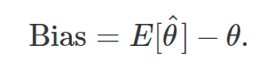
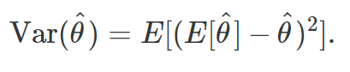
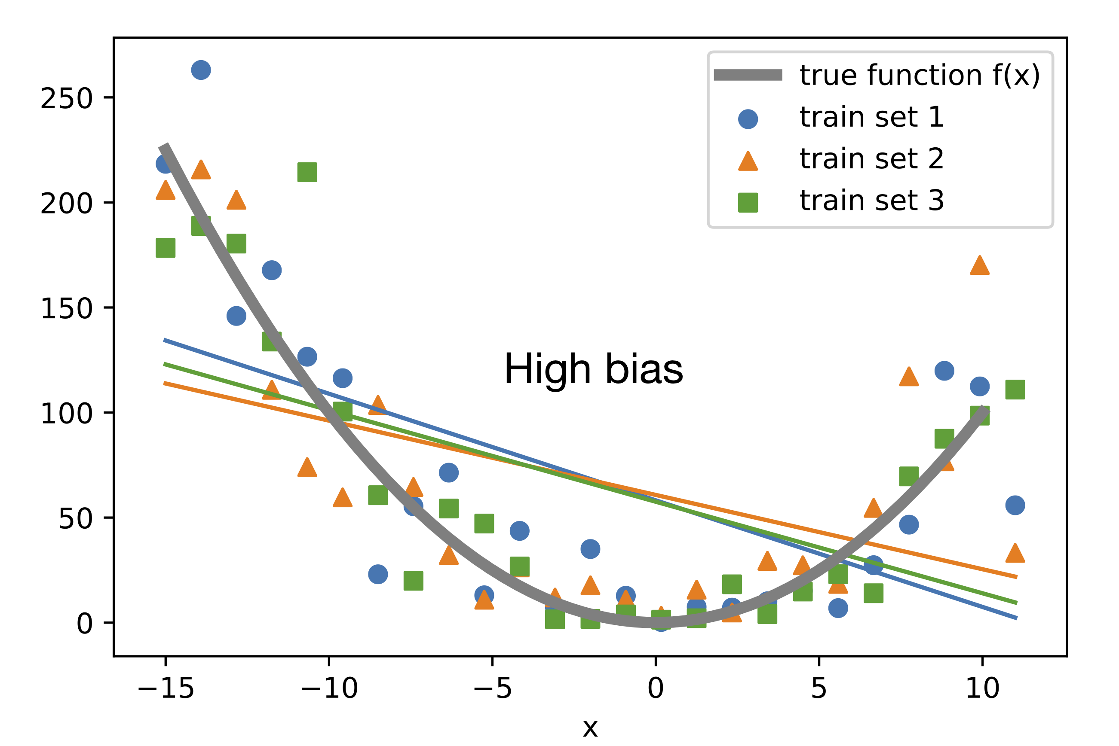
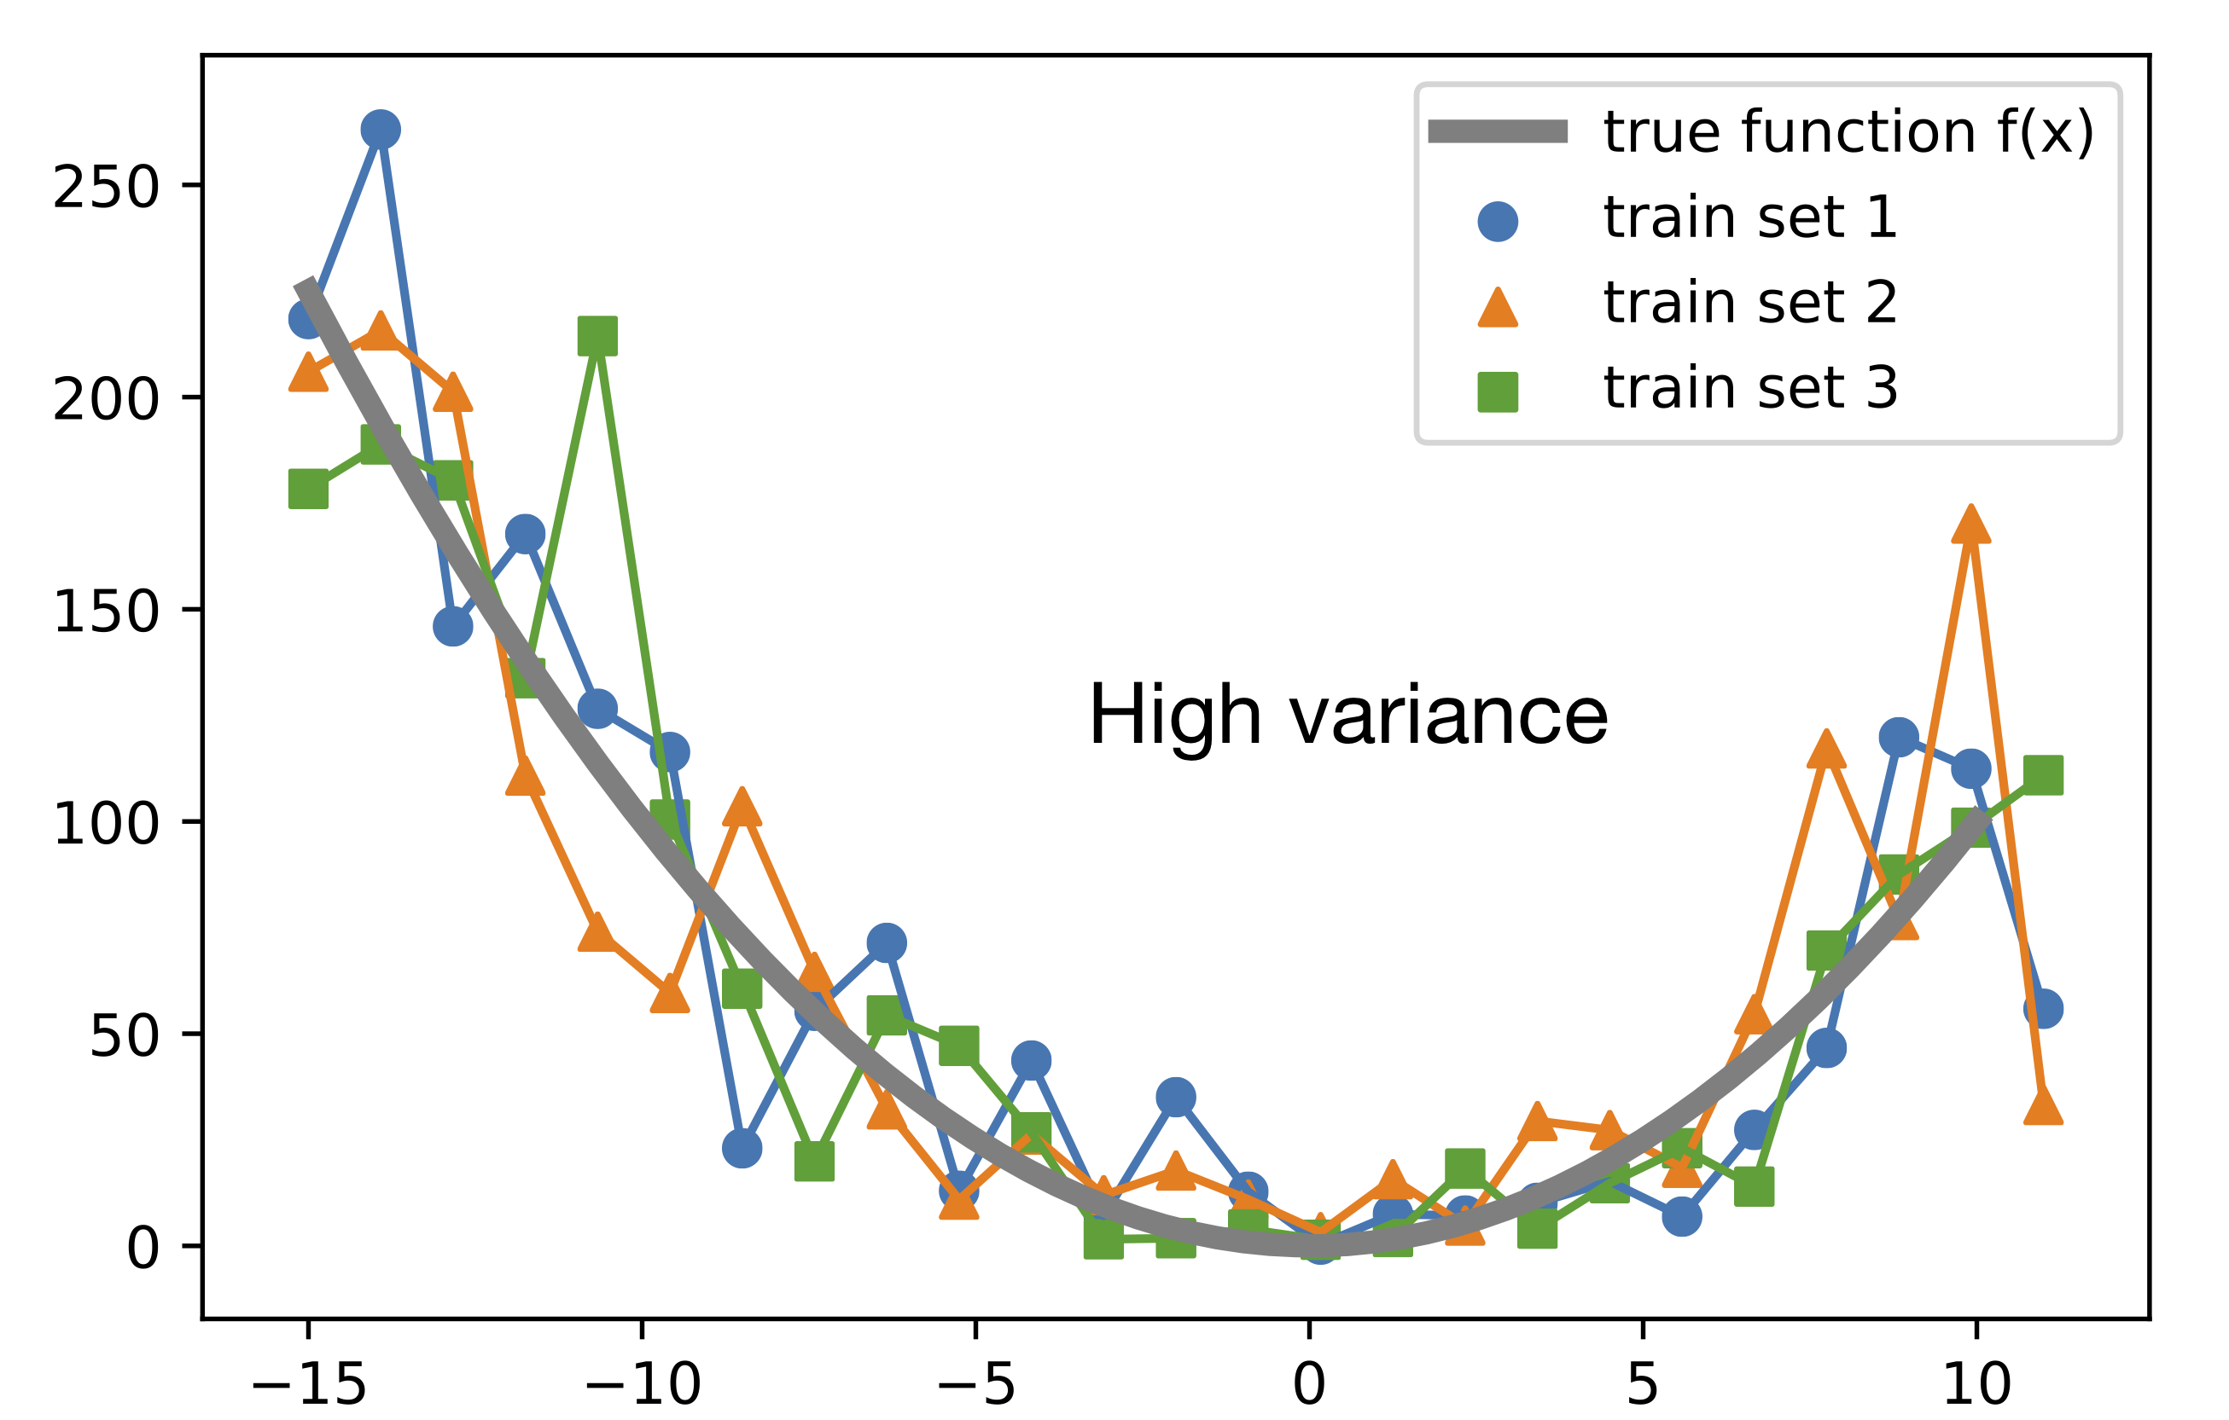
MSE is mean of squared errors between estimate and actual value

Slide 59
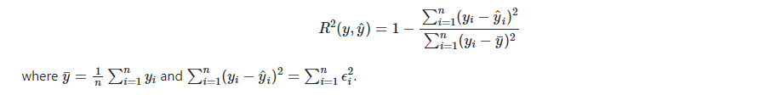
Definition of R-squared

